Slide 1
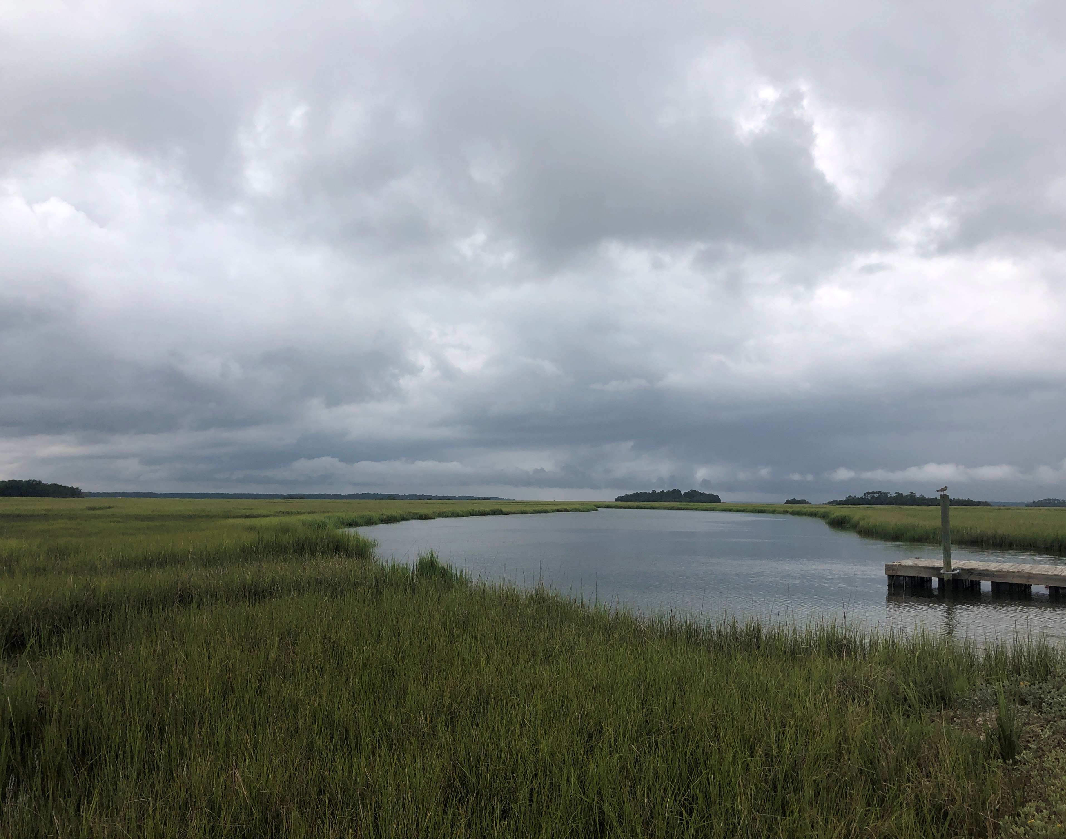


Exploring Dissolved Organic Matter Characteristics Across the Coastal Terrestrial-Aquatic Interface
Julia McElhinny
DOE SULI Intern

Slide 2
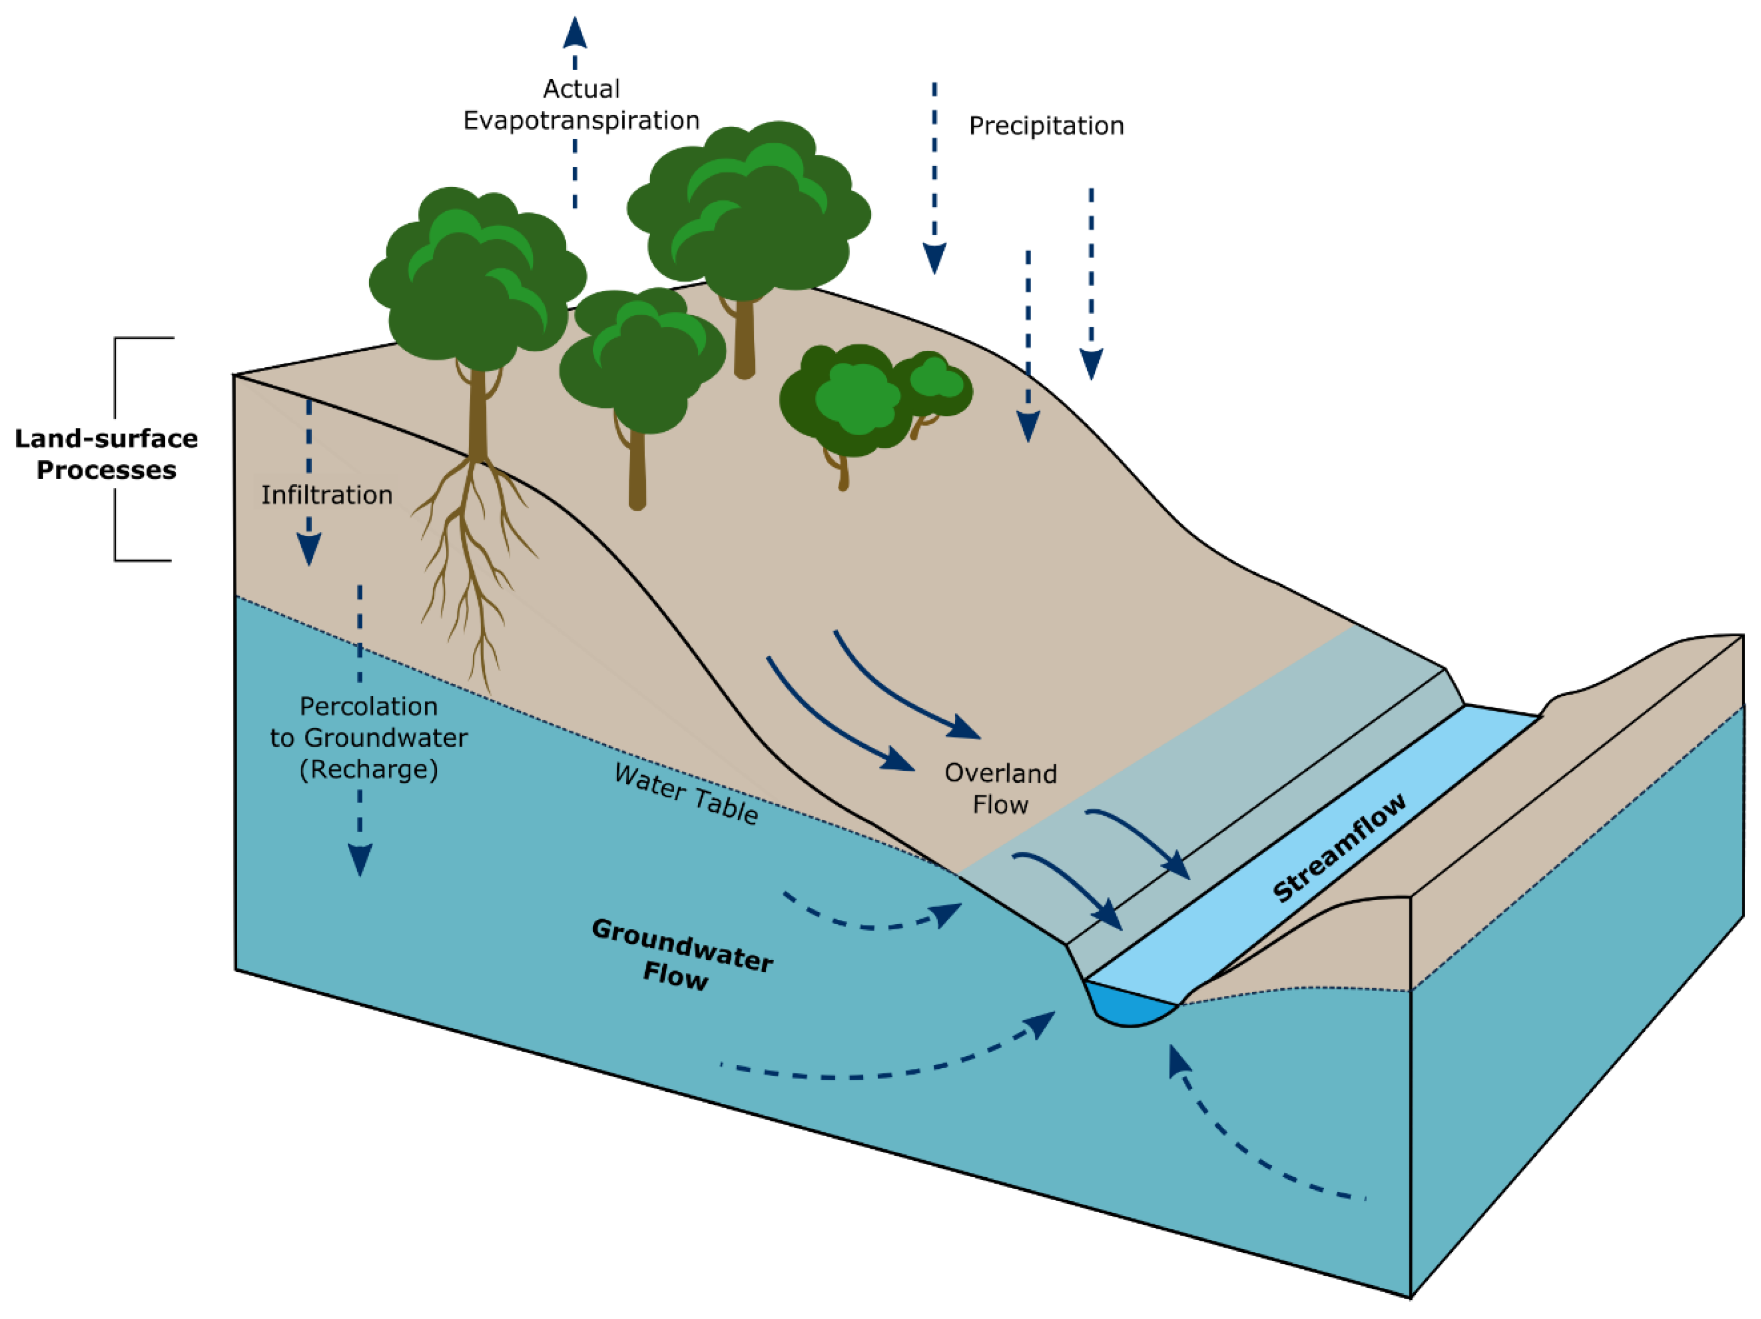
The Terrestrial Aquatic-Interface (TAI) is a Biogeochemical Hot Spot
Martin, N. (2021).
Notes:
TAIs are also very significant biogeochemical hot spots because of high biochemical reaction rates compared to surrounding areas.
Hydrologic flow is an important part of delivering the necessary reactants for these reactions to occur.

Slide 3
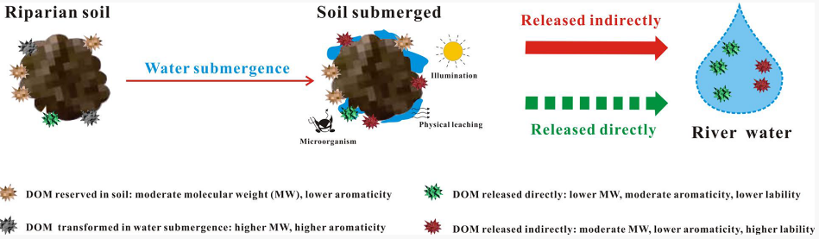
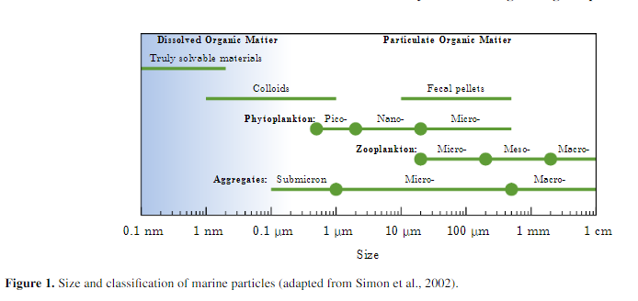
Dissolved Organic Matter (DOM)
Soil/Sediment
Moisture
Introduced water
Insoluble OM
WSOM
Degradation,
Leaching
Water
WSOM = Water Soluble Organic Matter
Adapted from Wang et. al. (2021) and Tao et. al. (2000).
Monroy et. al. (2017).
Notes:
One reactant that is actively transported from soils to waterways is dissolved organic matter (DOM).
Very small organic molecules, often on the scale of micro and nanometers, derived from the decomposition of plant and animal inputs to soils.
In soils, usually found in porewater or attached to surrounding soil molecules.
DOM is hard to research directly, so WSOM is typically used instead! Produced

Slide 4
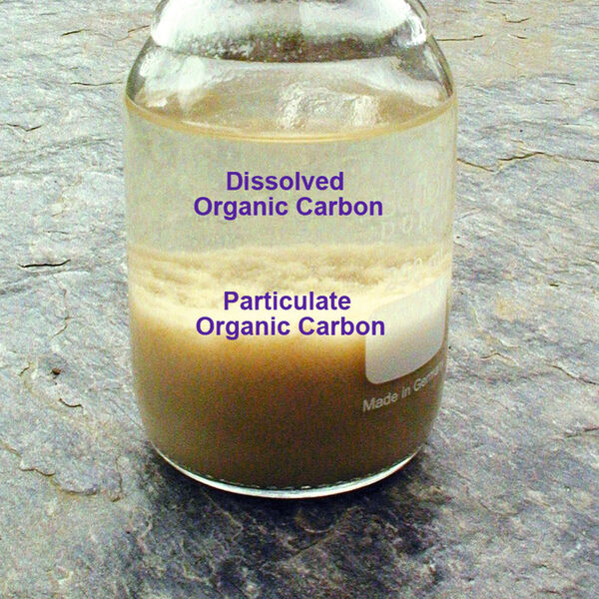
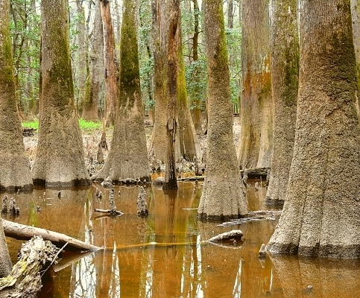
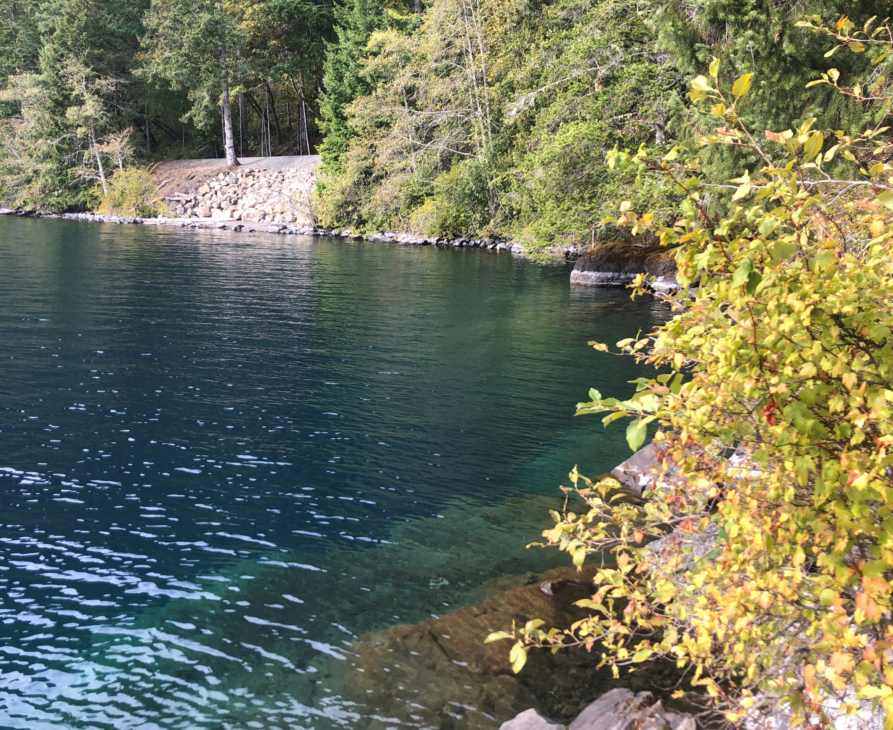
Aquatic DOM
Colorized Dissolved Organic Matter (CDOM)
VS
Congaree National Park, SC
Lake Crescent, WA
process-worldwide.com
meanstoexplore.com
Image taken by Julia McElhinny

Slide 5
OM fluxes are very important to understand!
For microbes
Understanding carbon cycle sources and sinks
Understanding ecosystem productivity:
NPP = GPP – R - E
Terrestrial export
Riverine export to ocean
Soil carbon pool
Adapted from Martin, N. (2021) and Tank et. al. (2018).
Notes:
Understanding OM characteristics across the landscape helps us determine the kind of biogeochemical processing that can occur and therefore its ease in being transported.

Slide 6
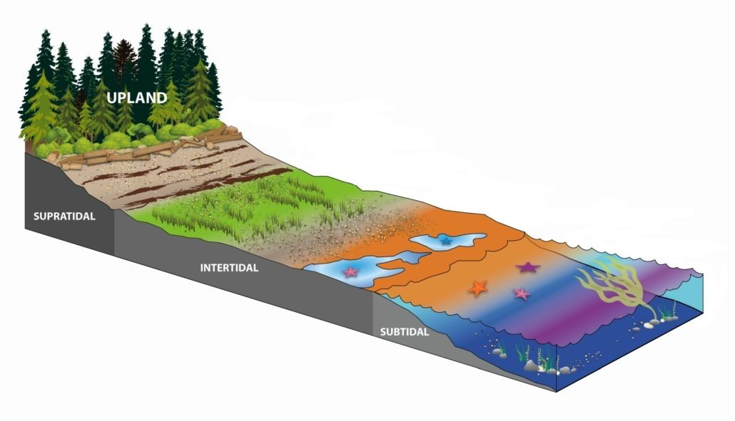
Our Goal: Understand DOM Characteristics and Linkages Across the TAI Gradient
Do DOM characteristics (concentrations and composition) differ spatially across the gradient?
Can we make some conclusions about how DOM is being transformed across the landscape?
TRANSITION
WETLAND
SURFACE WATER
Figure adapted from estuaries.org
Notes:
As terrestrially-derived DOM is an important input for aquatic systems, many previous studies have investigated how landscape-level variables such as land cover, land use, soil type, and precipitation are related to DOM fluxes.
Less is known about the specific biogeochemistry of soil DOM and how its transformations relate to DOM pools in adjacent waters, especially across a large spatial scale.
So, we aimed to…

Slide 7
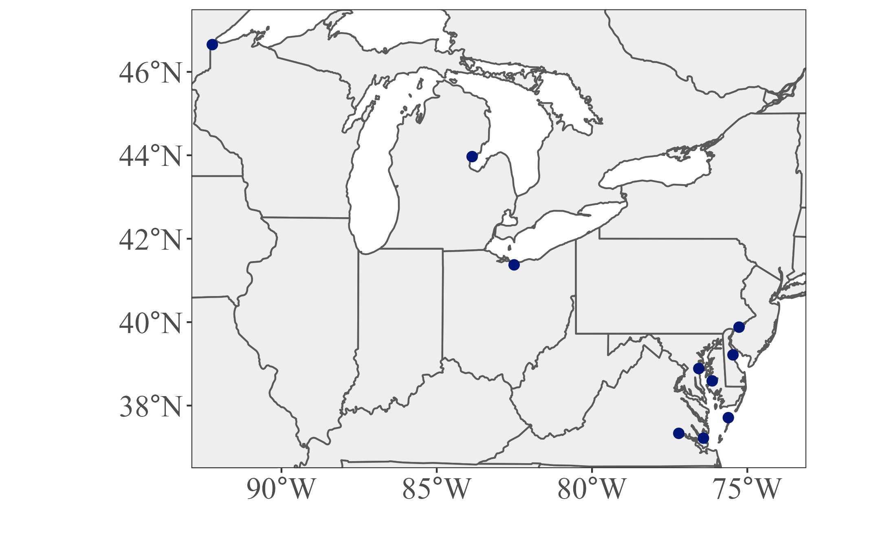
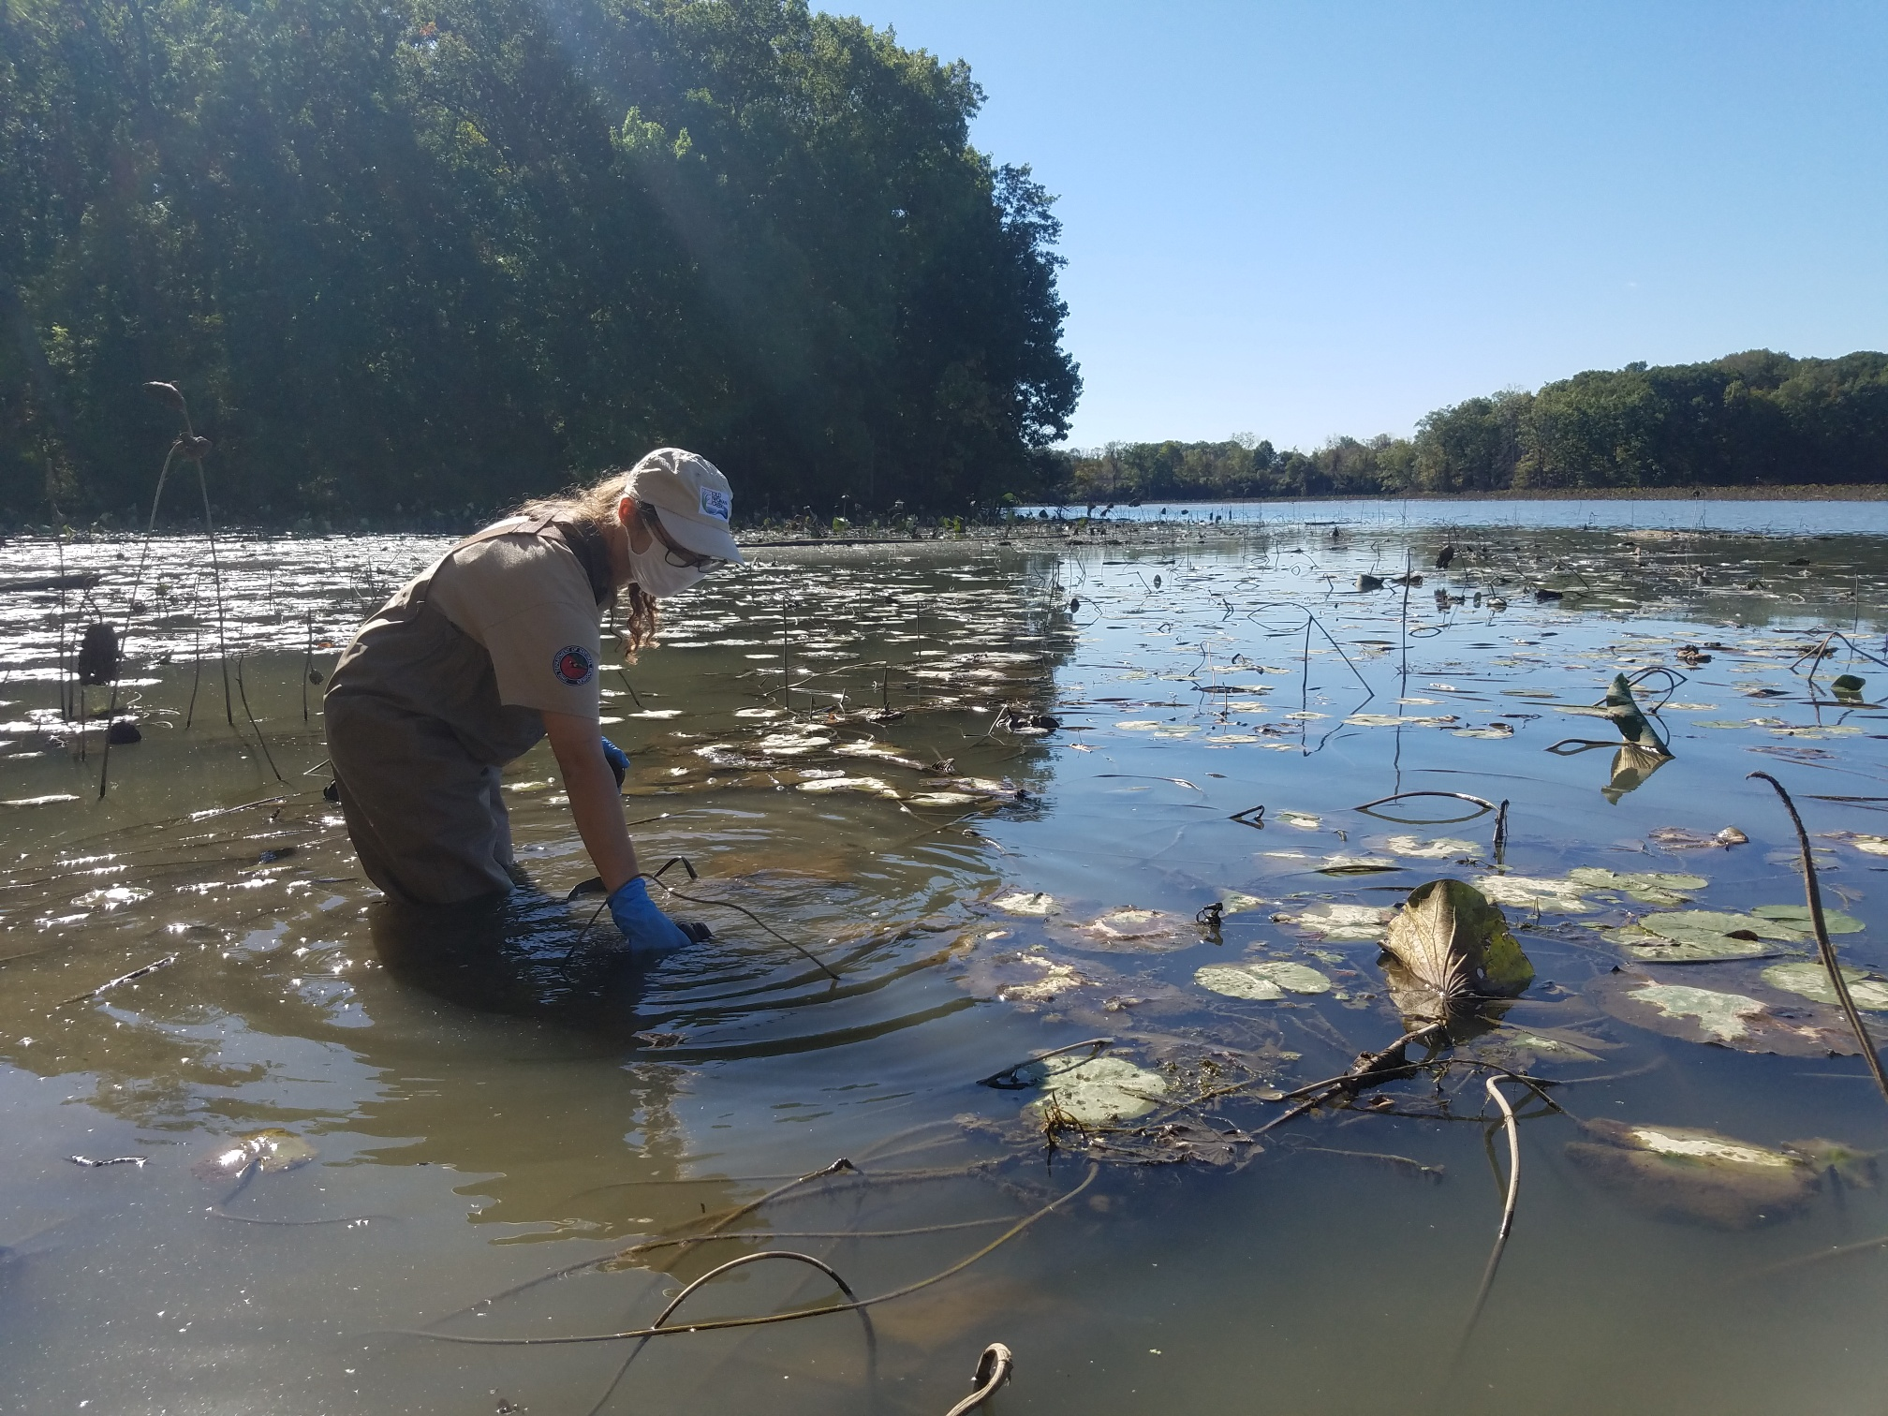
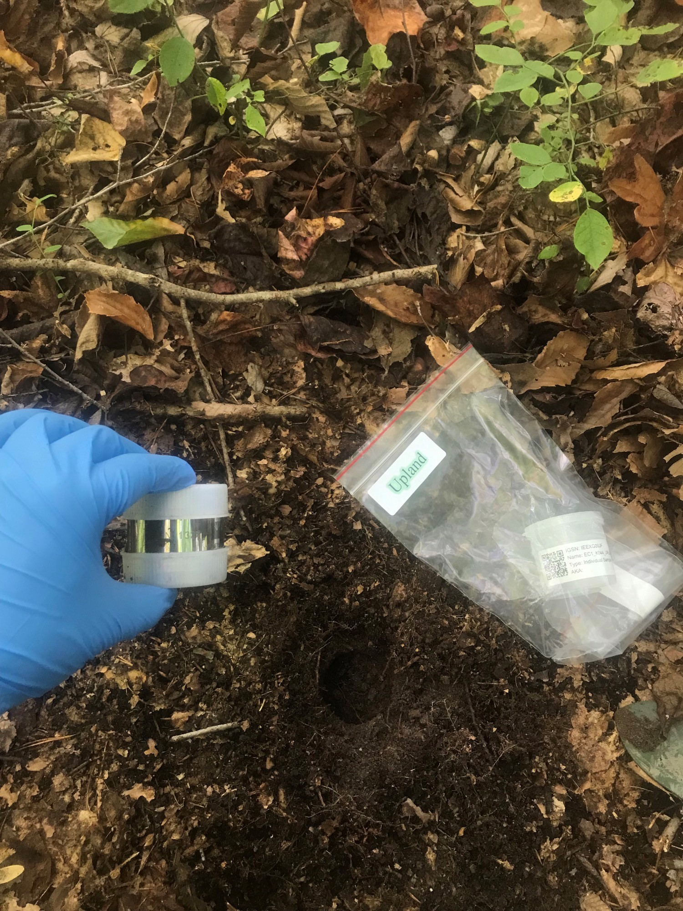
Sampling Sites
10 sites: 3 Great Lakes, 7 Mid-Atlantic
3 soil samples at each site across the TAI gradient
1 surface water sample at each site
Image credit: EXCHANGE consortium
Notes:
Gain a little spatial resolution with sites from the largest estuary on the continent and the largest freshwater system in the world!!

Slide 8
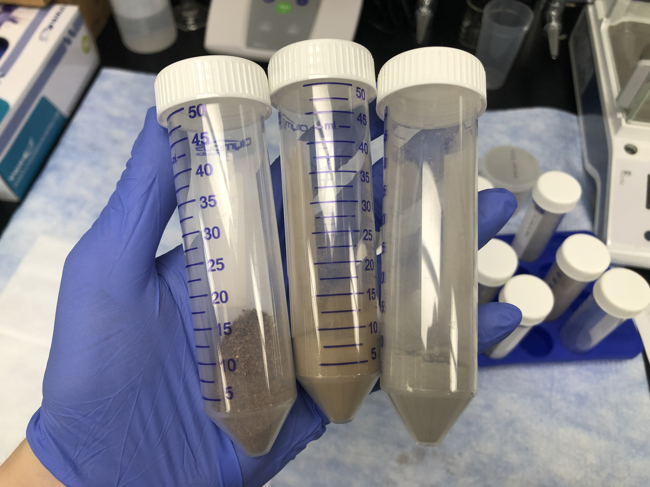
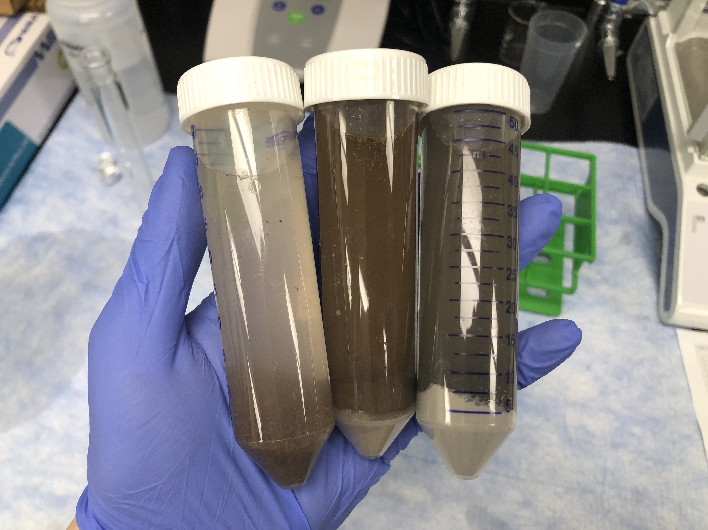
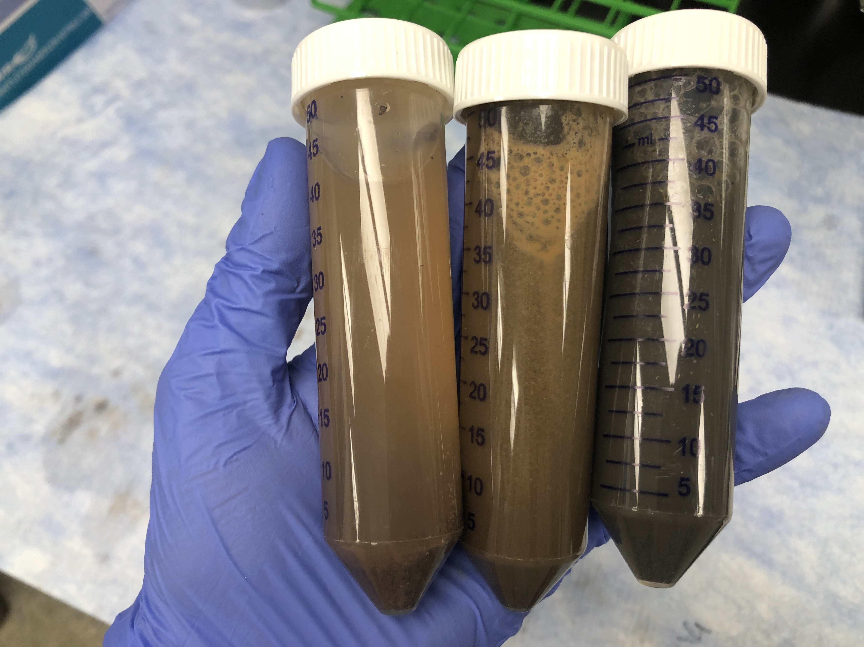

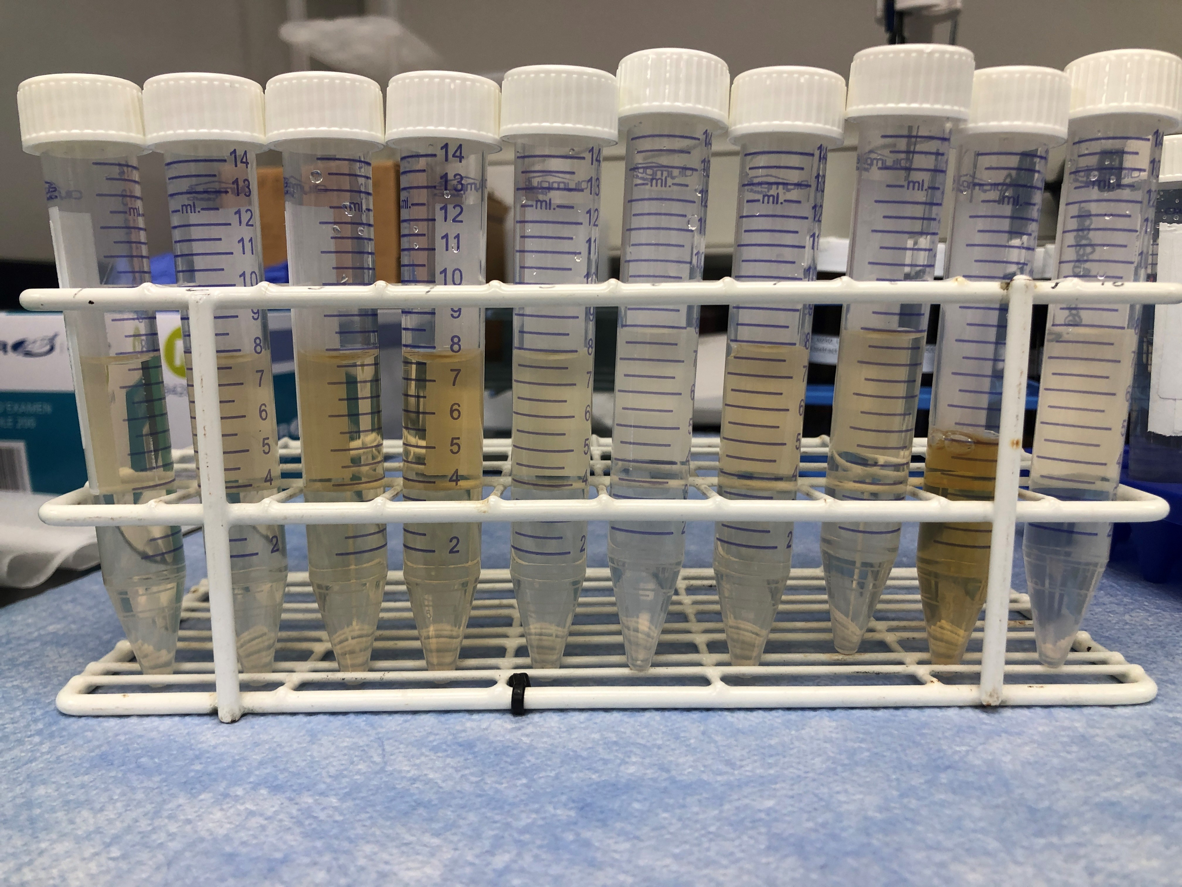
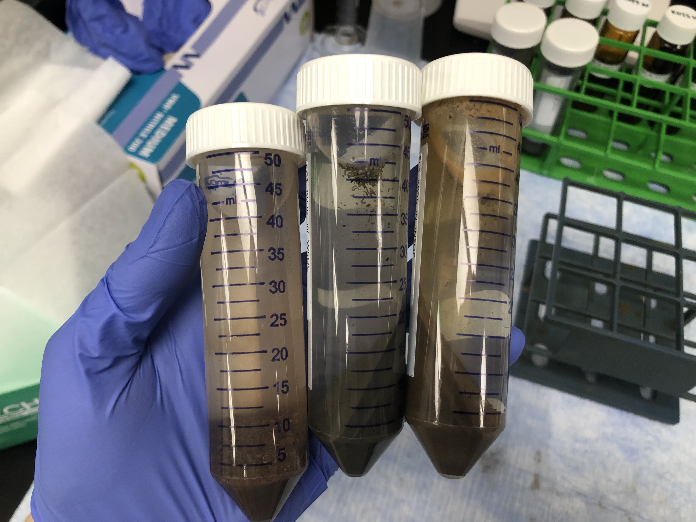
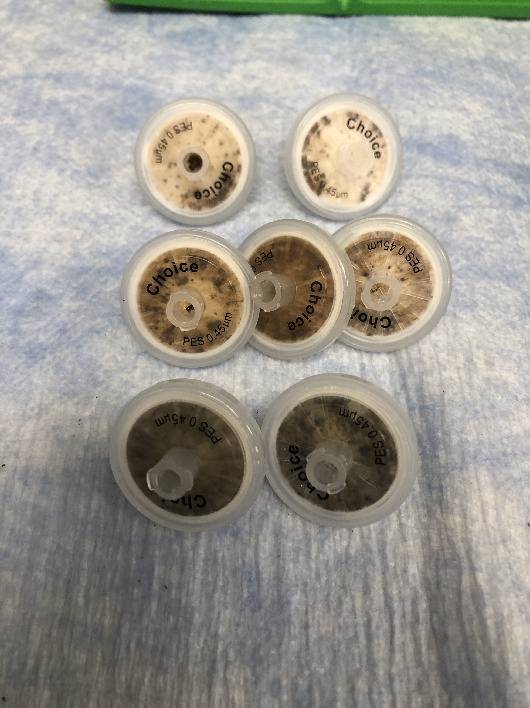
Extracting Water-Soluble Organic Matter (WSOM) from Soils
MQ water added
Shaken for 1 hour
Filtered (0.45 µm)
Centrifuged for 15 min

Slide 9
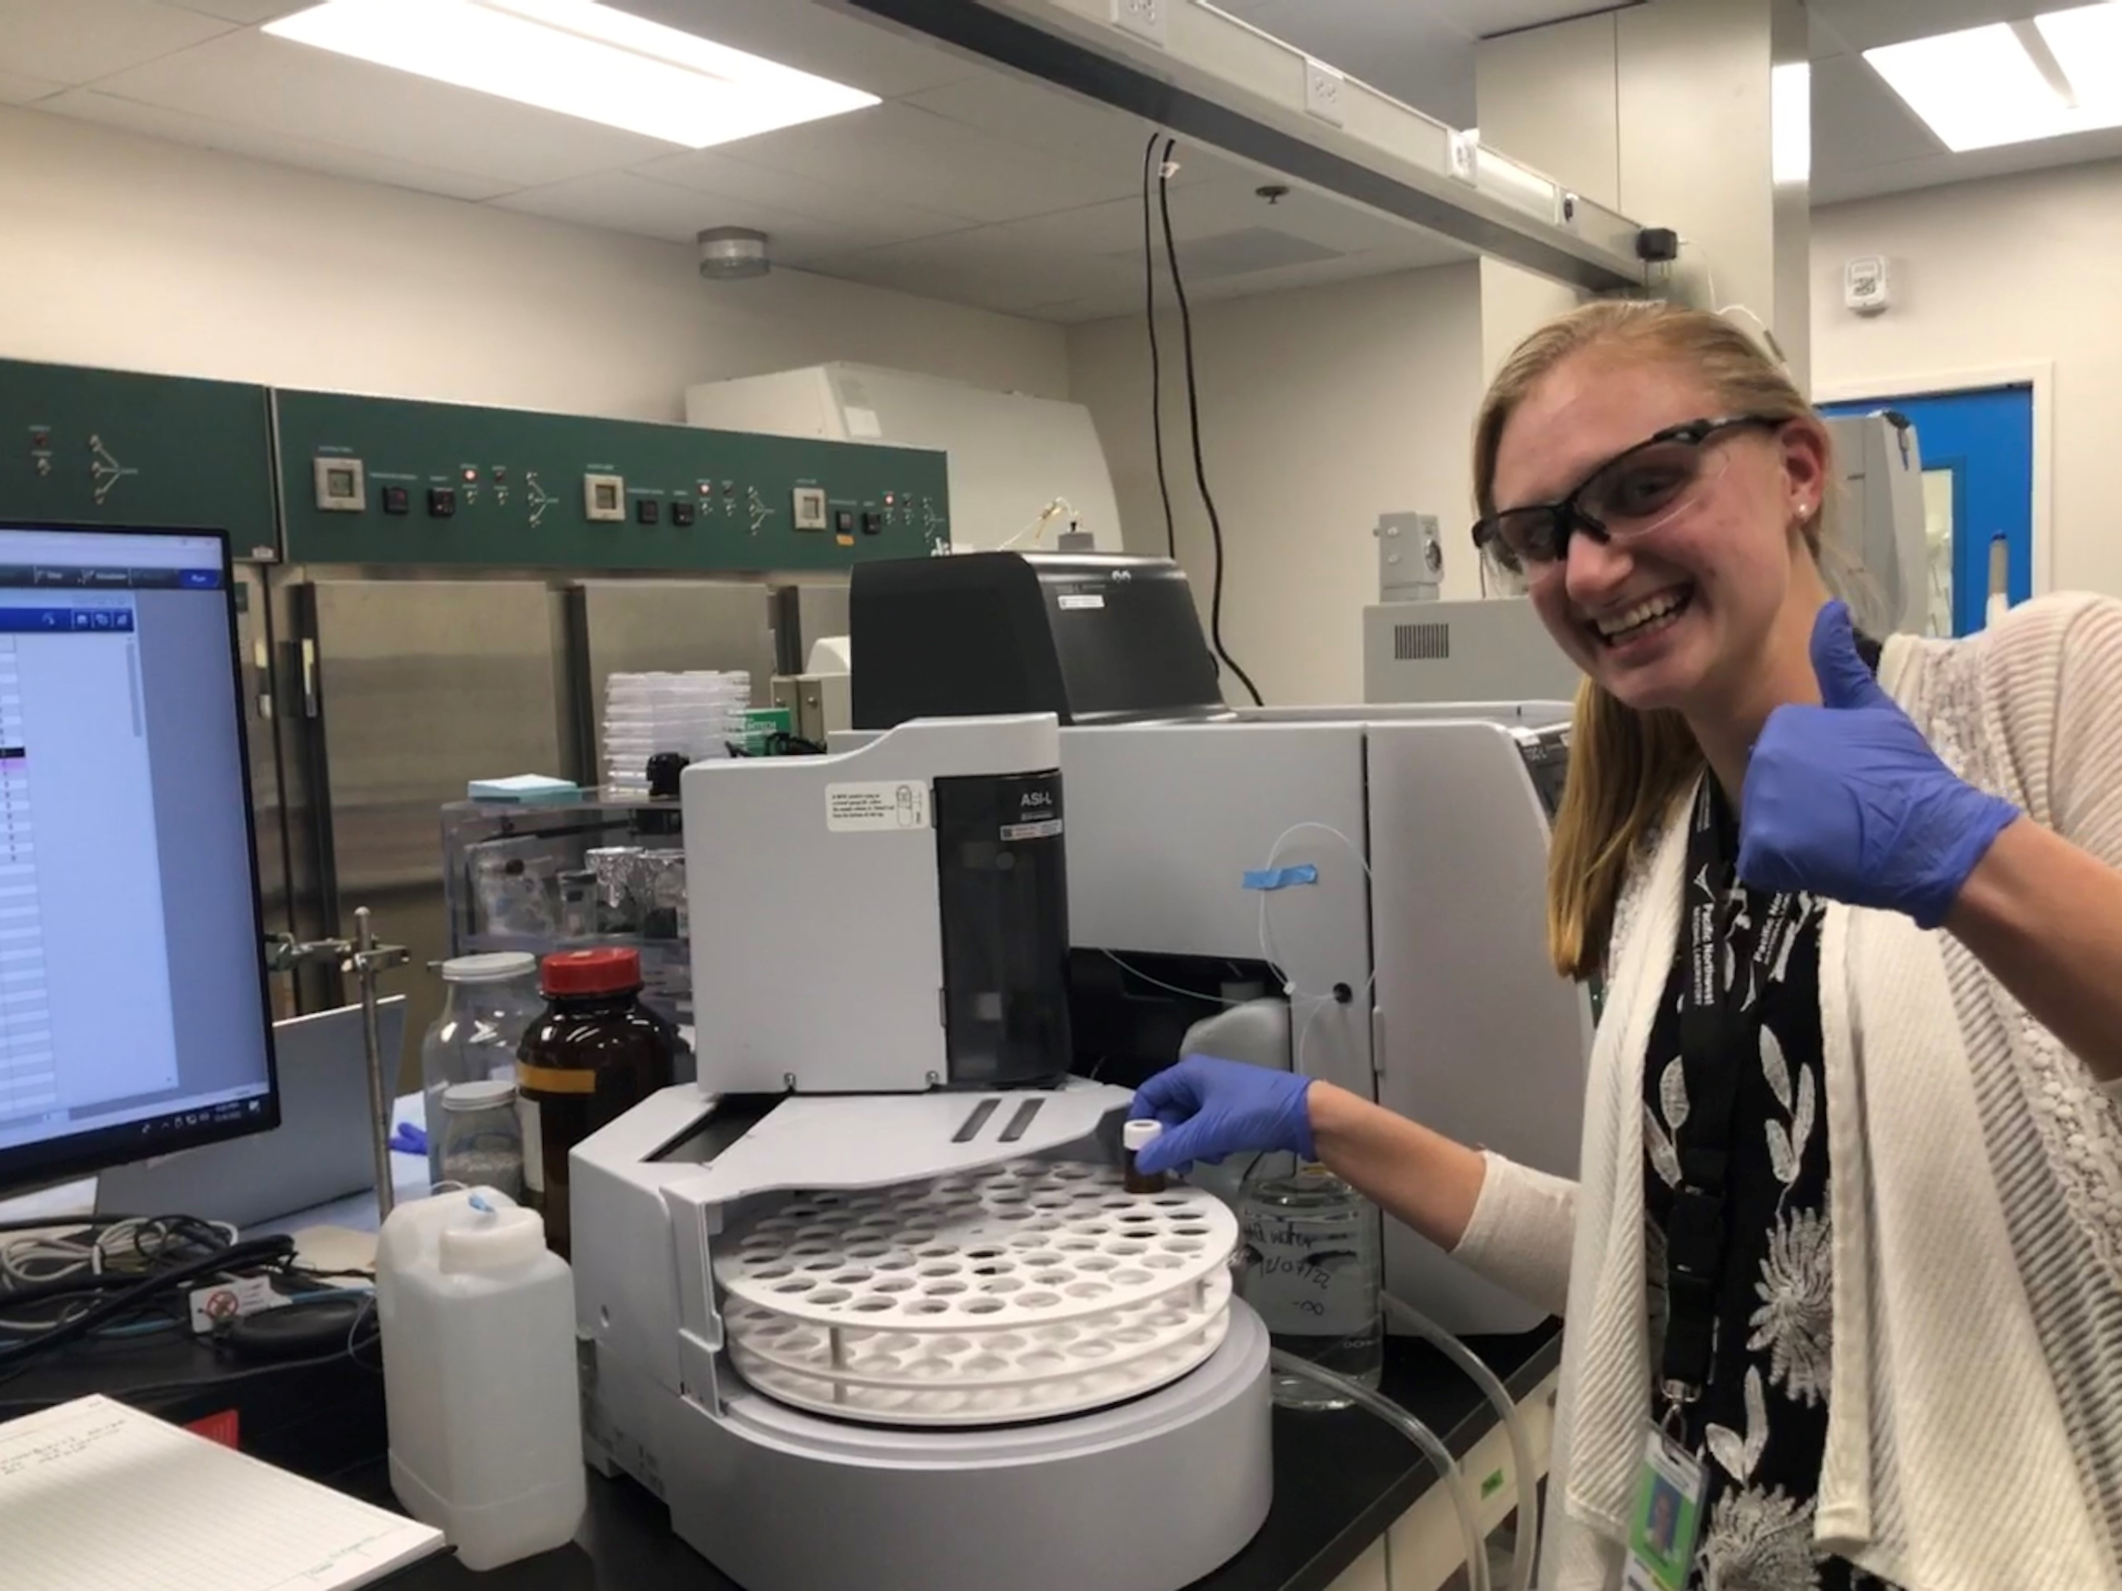
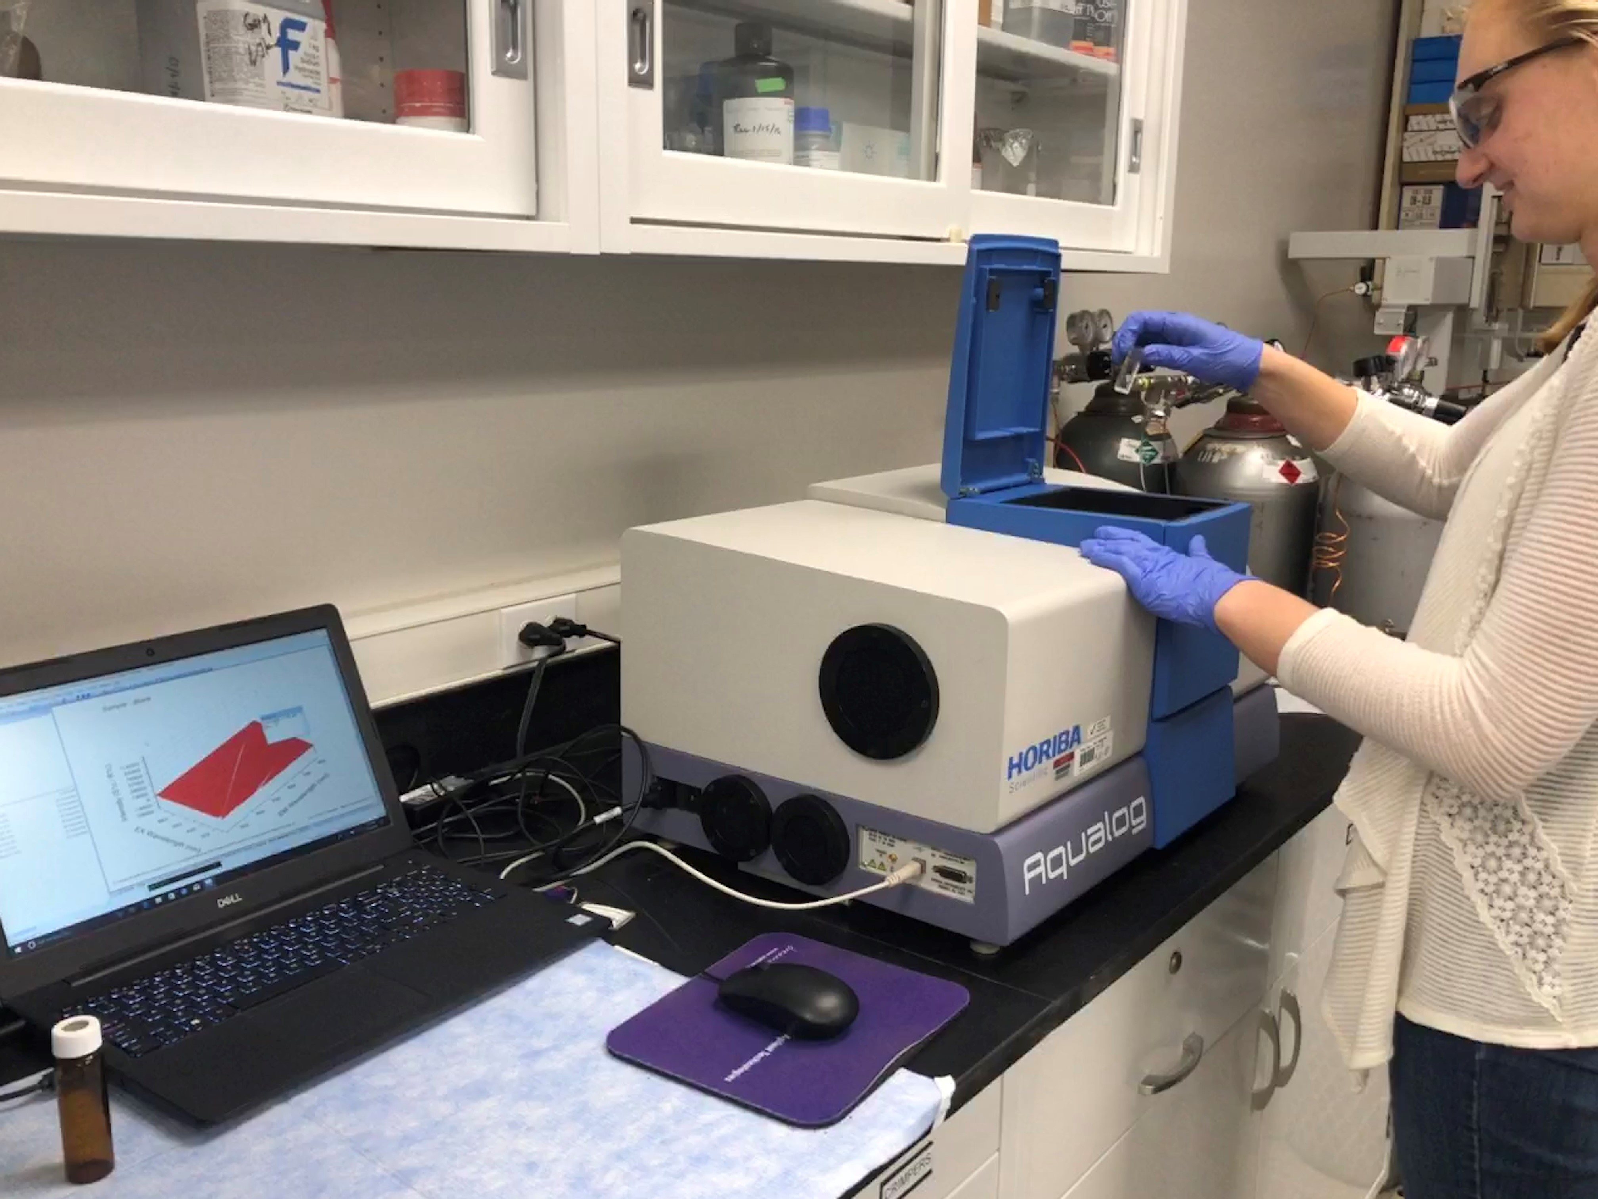
After collection, extracts and water samples were then run on two different instruments.
Total Organic Carbon Analyzer, to determine WSOM concentrations
Aqualog, to collect spectral data on CDOM

Slide 10
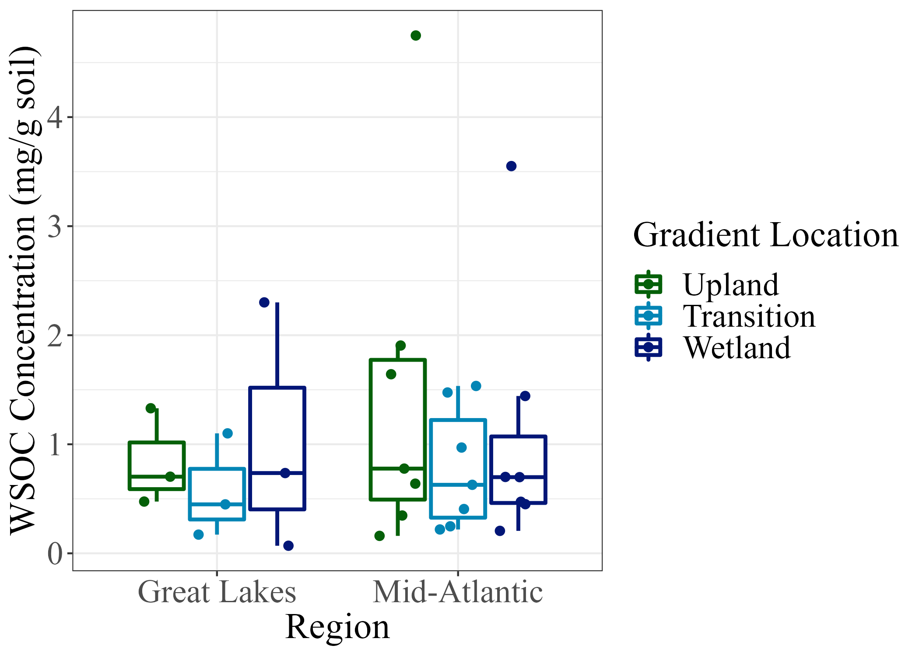
WSOC/DOC Concentration Across the TAI Gradient
Notes:
WSOC concentration was not statistically significant between locations on the TAI gradient or between sample site regions.

Slide 11
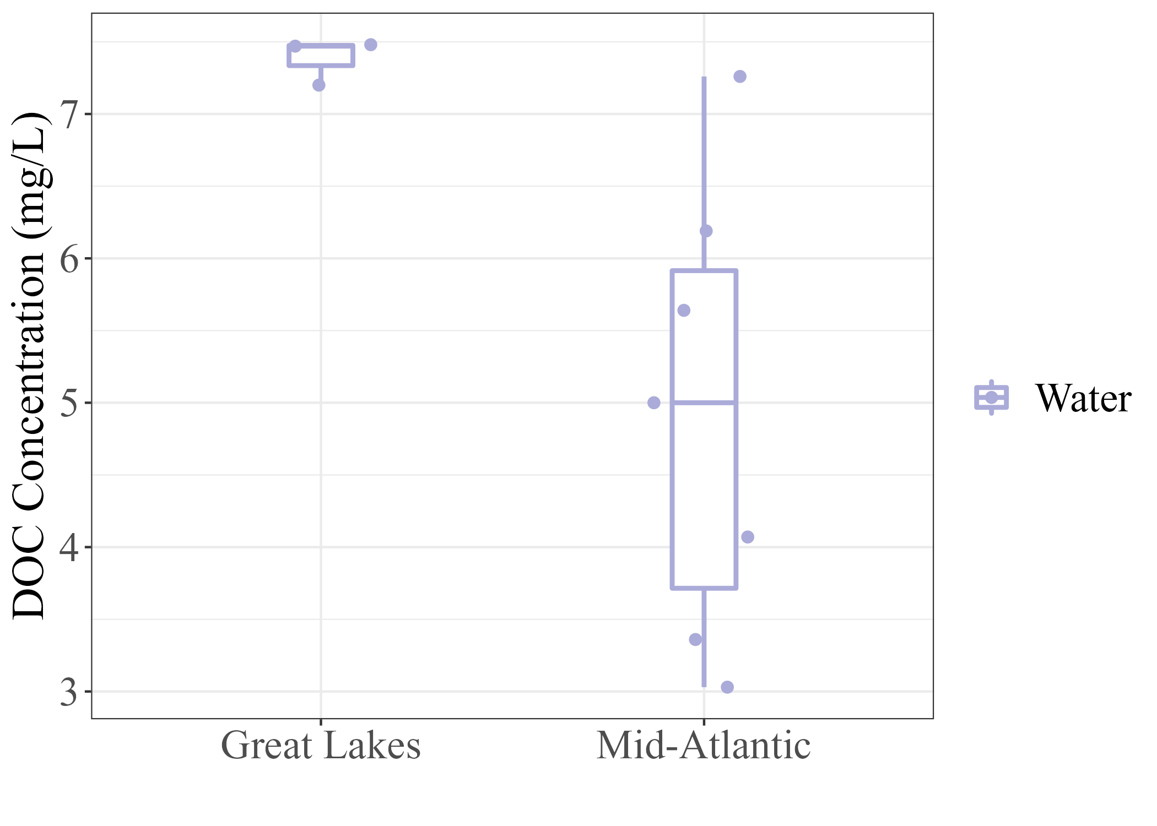
WSOC/DOC Concentration Across the TAI Gradient
Notes:
WSOC concentration was not statistically significant between locations on the TAI gradient or between sample site regions.

Slide 12
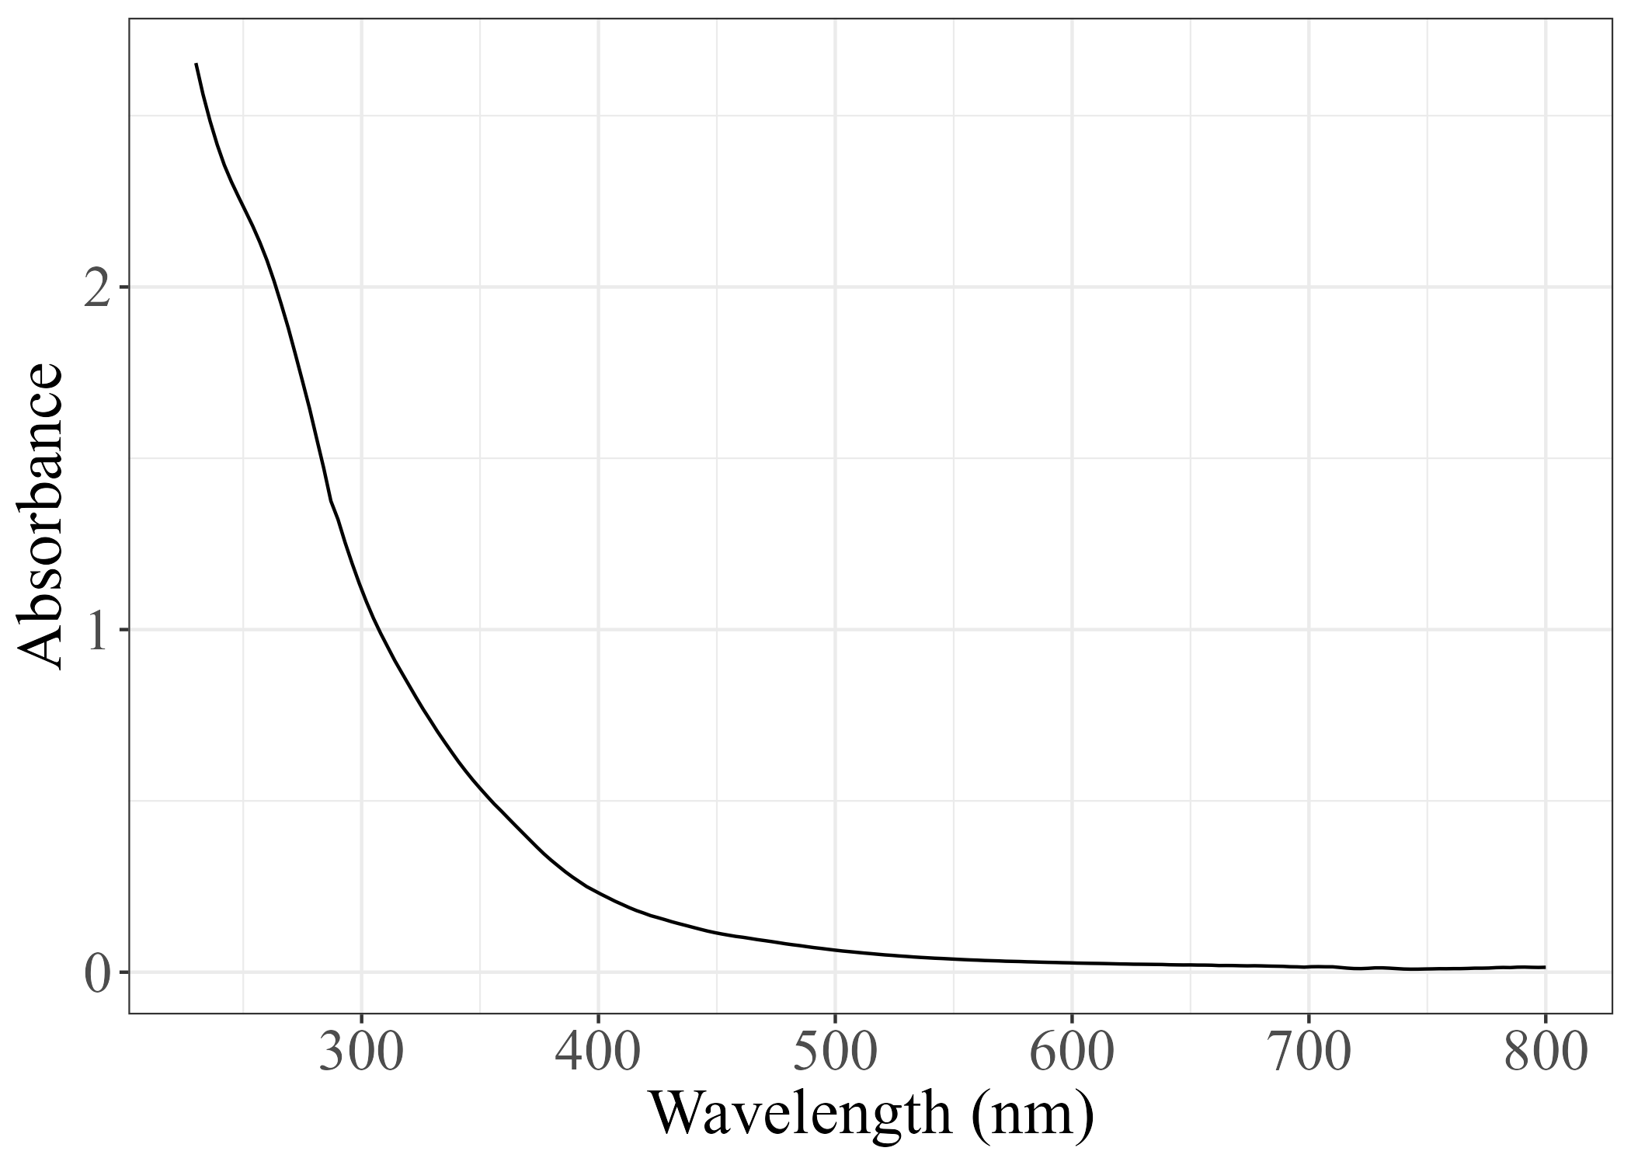
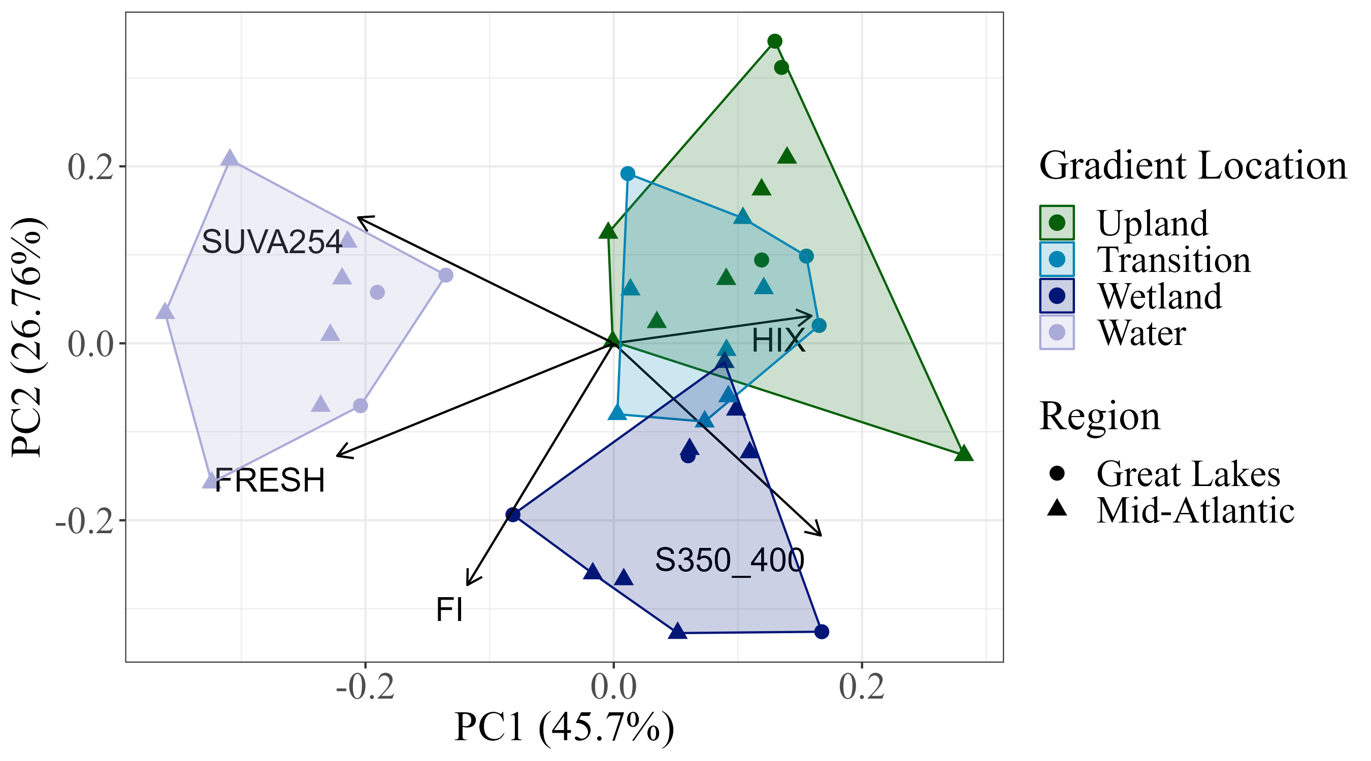
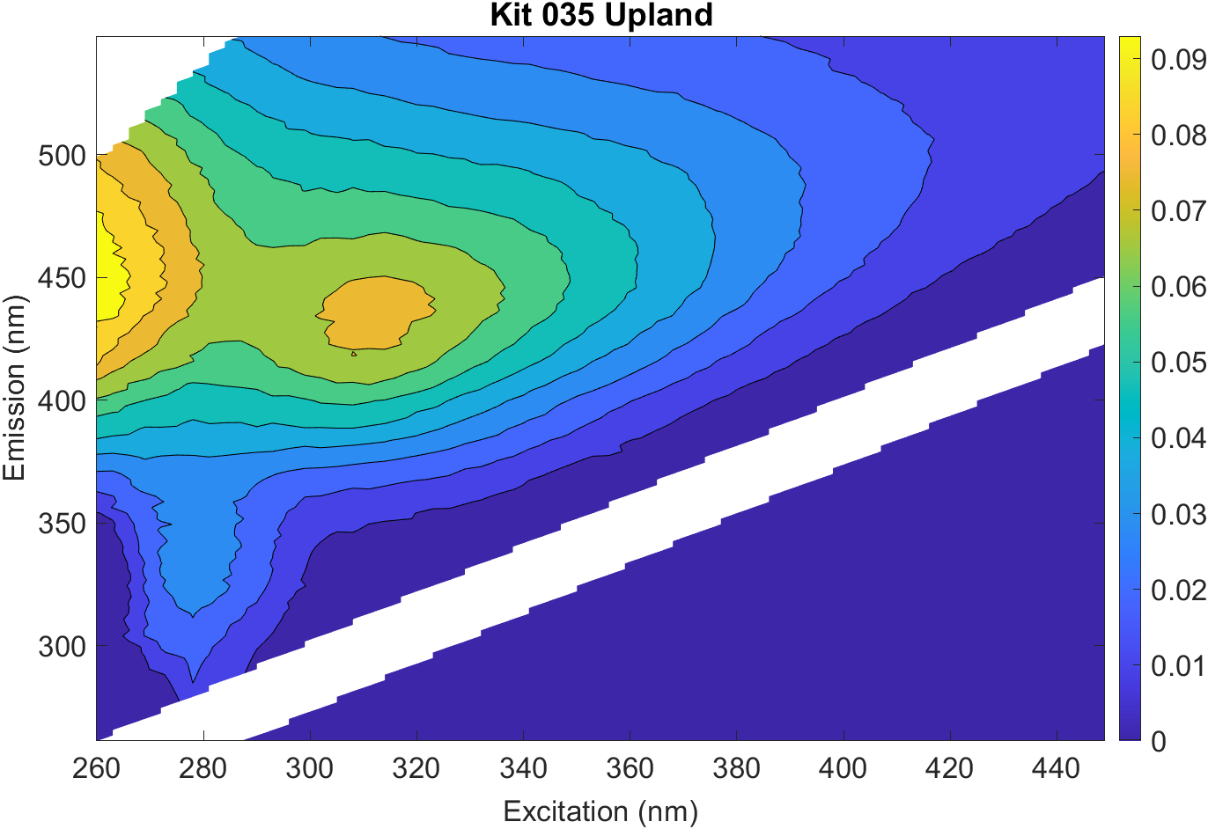
OM Composition: Using Spectral Metrics from Aqualog Data
SUVA254 = Specific UV Absorbance at 254nm
S350_400 = Spectral slope from 350-400nm
FRESH = Freshness Index
HIX = Humification Index
FI = Fluorescence Index

Slide 13
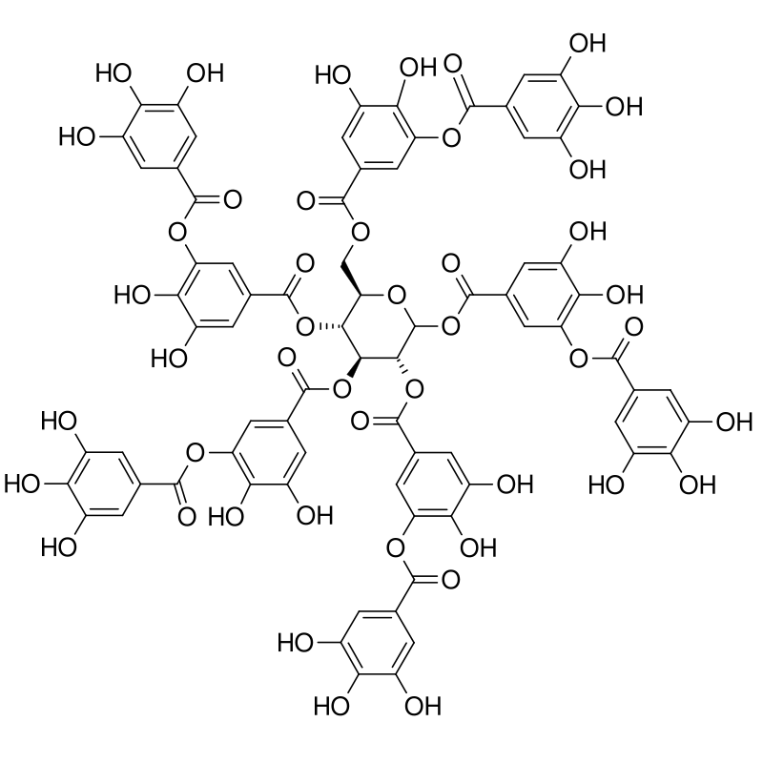
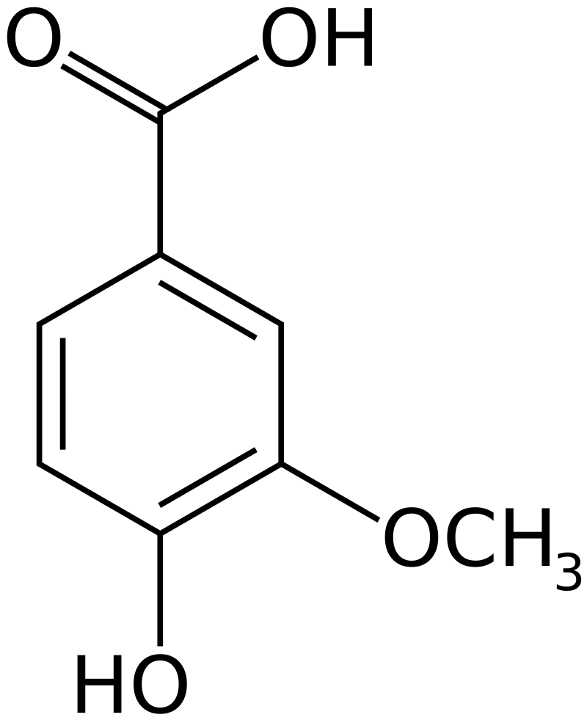
More aromatic,
heavier DOM
More terrestrial
More recently produced
More microbial
Less aromatic,
lighter DOM
Notes:
Little note here: preliminary k-means clustering analysis resulted in cluster 2 dominated entirely by surface waters! Other three clusters with significant overlap similar to what this PCA shows
Example molecules are vanillic acid (small) and a tannin (large)

Slide 14
Summary: Dissolved Organic Matter Across the TAI Gradient
Aromatic, heavier DOM of terrestrial origin
Less aromatic, lighter DOM of microbial origin
Recently-produced, aromatic, heavier DOM
{
TRANSITION
WETLAND
SURFACE WATER
Approximately equal soil DOM concentrations
Upstream inputs
Figure adapted from estuaries.org

Slide 15

Acknowledgements
HUGE thank you to:
My mentor, Allison Myers-Pigg
Alan Roebuck
Opal Otenburg
Khadijah Homolka
Kaizad Patel
This work was supported in part by the U.S. Department of Energy, Office of Science, Office of Workforce Development for Teachers and Scientists (WDTS) under the Science Undergraduate Laboratory Internships Program (SULI).

Slide 16
Thank you!

Slide 17
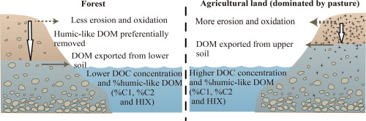
Land Cover Impacts on Aquatic DOM
Shang et al. (2018).

Slide 18
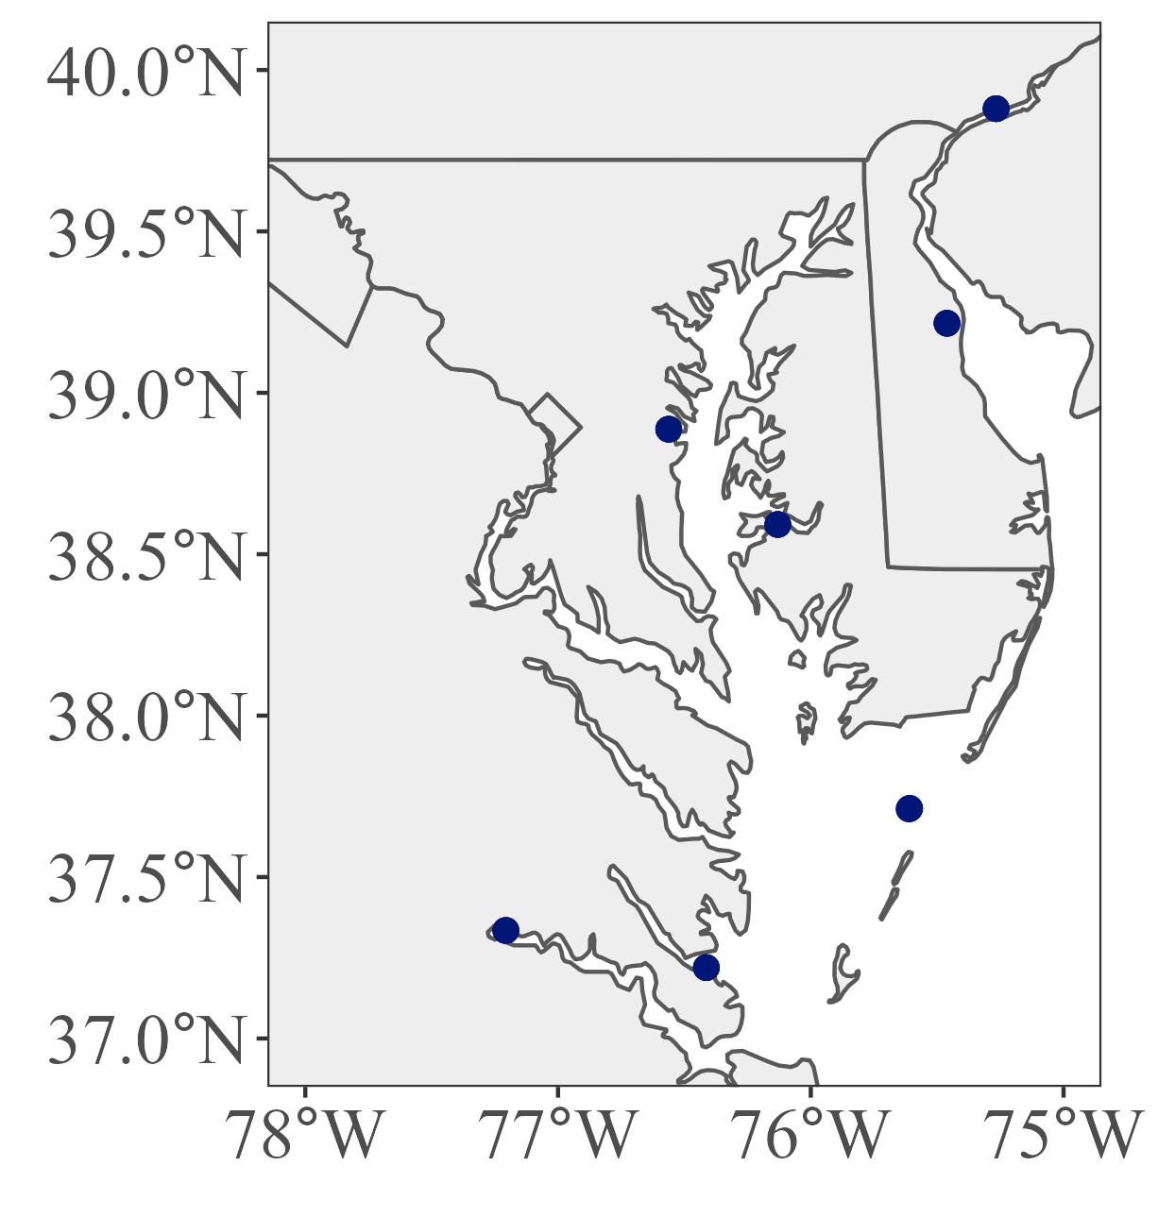
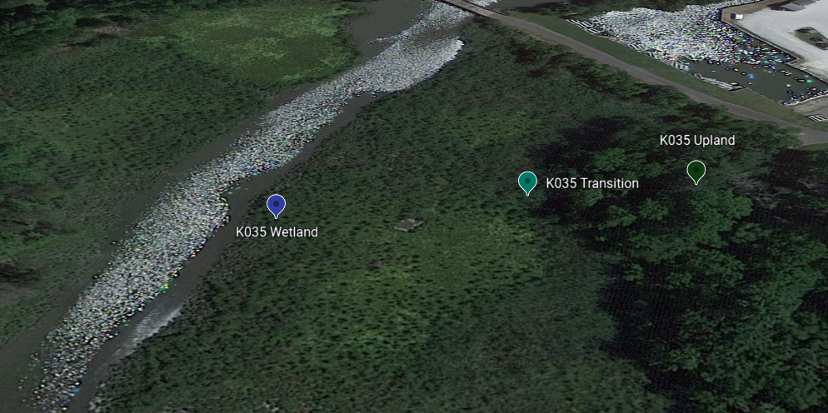
TAI Gradient

Slide 19
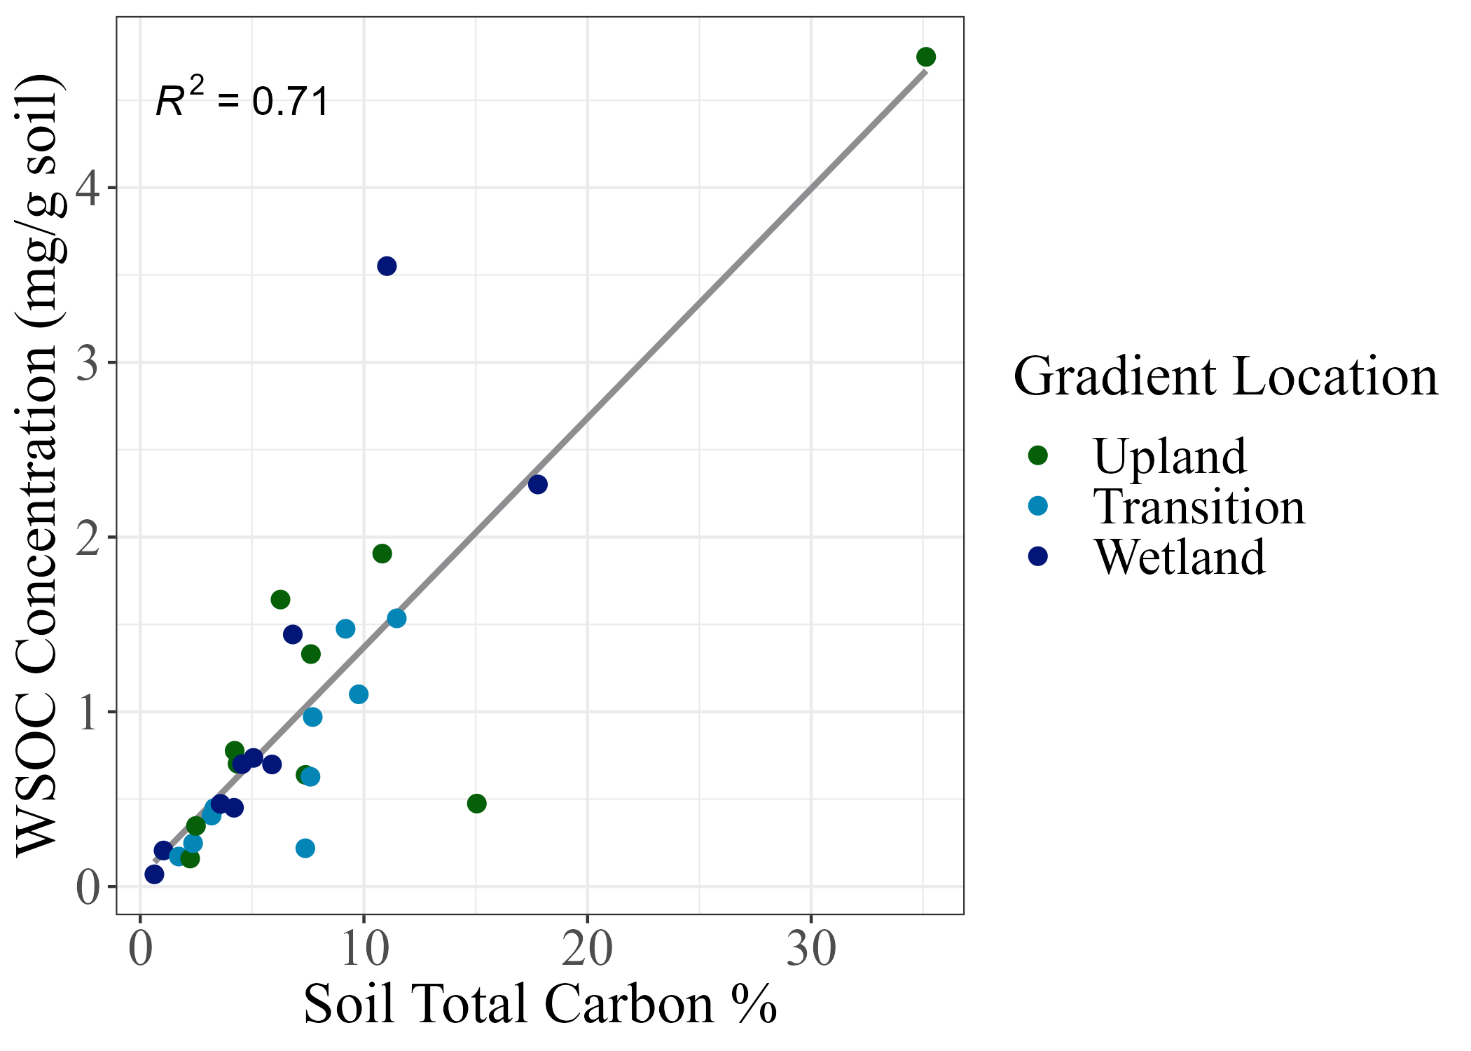
Relationship between WSOC Concentration and Total Soil Carbon Percentage

Slide 20
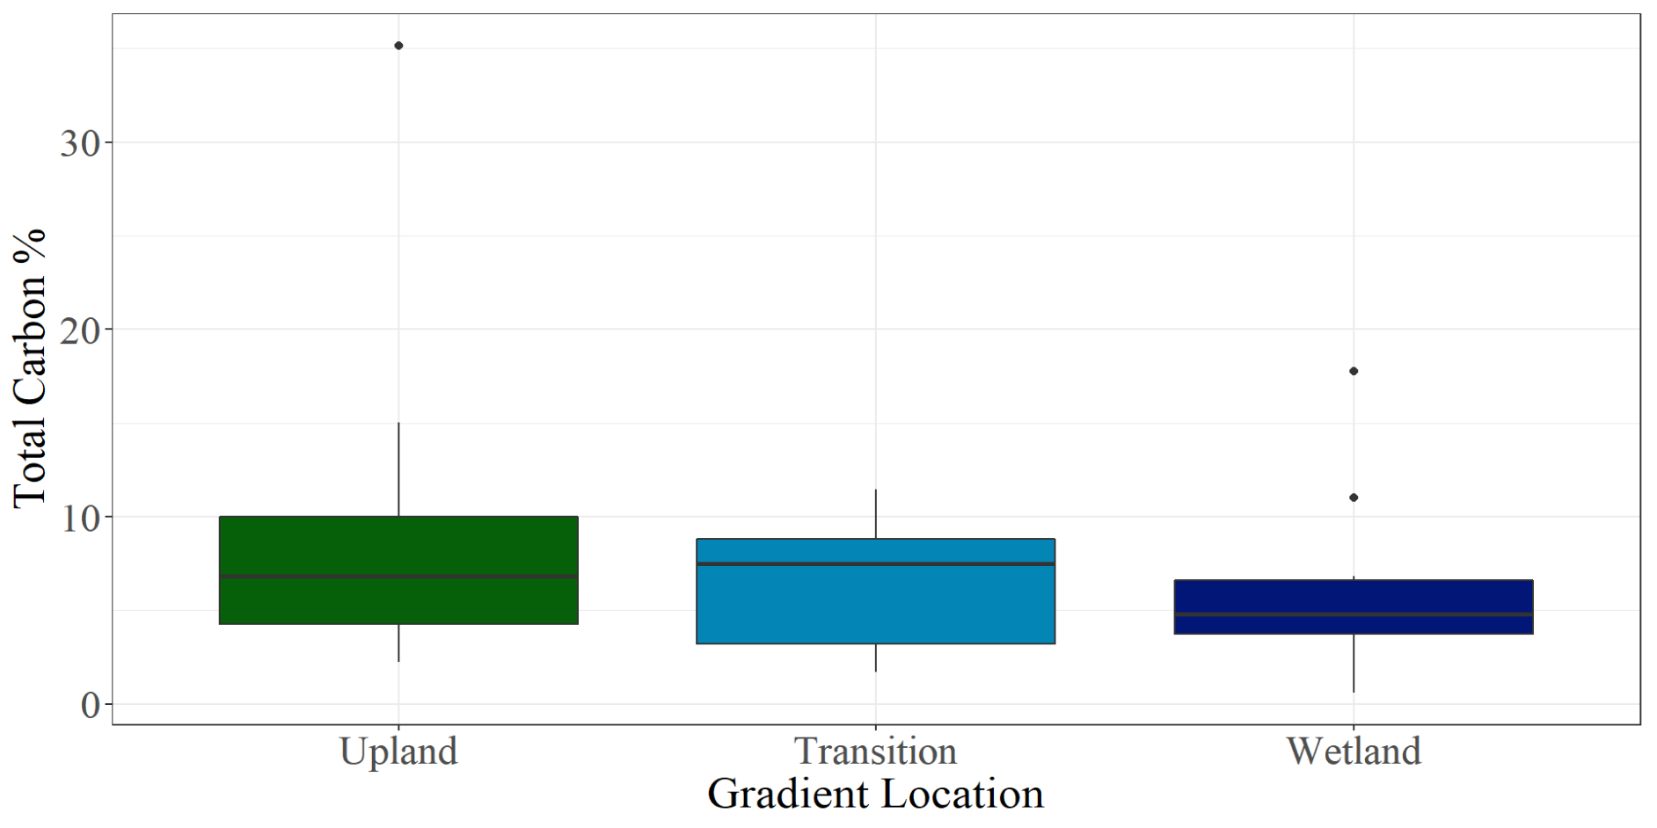
Soil Total Carbon Percentages Across the TAI Gradient

Slide 21
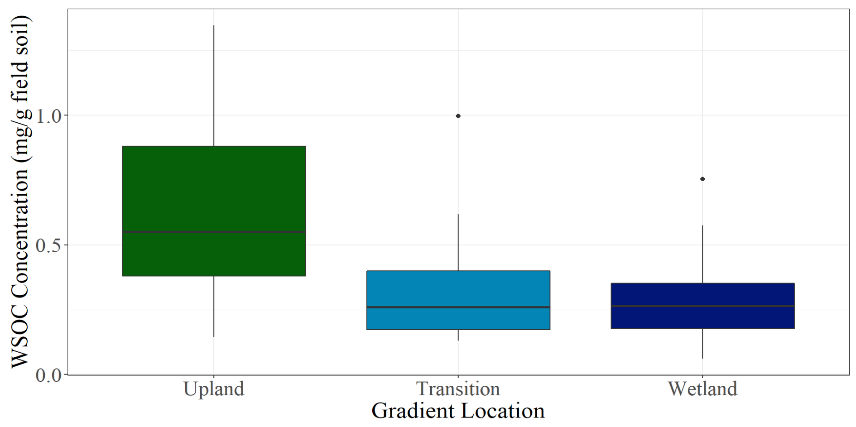
WSOC Concentrations, Extrapolated to Field Moist Soils Using Gravimetric Water Content
*
*
Notes:
Stars indicate a statistically significant difference at the p = 0.1 level.

Slide 22
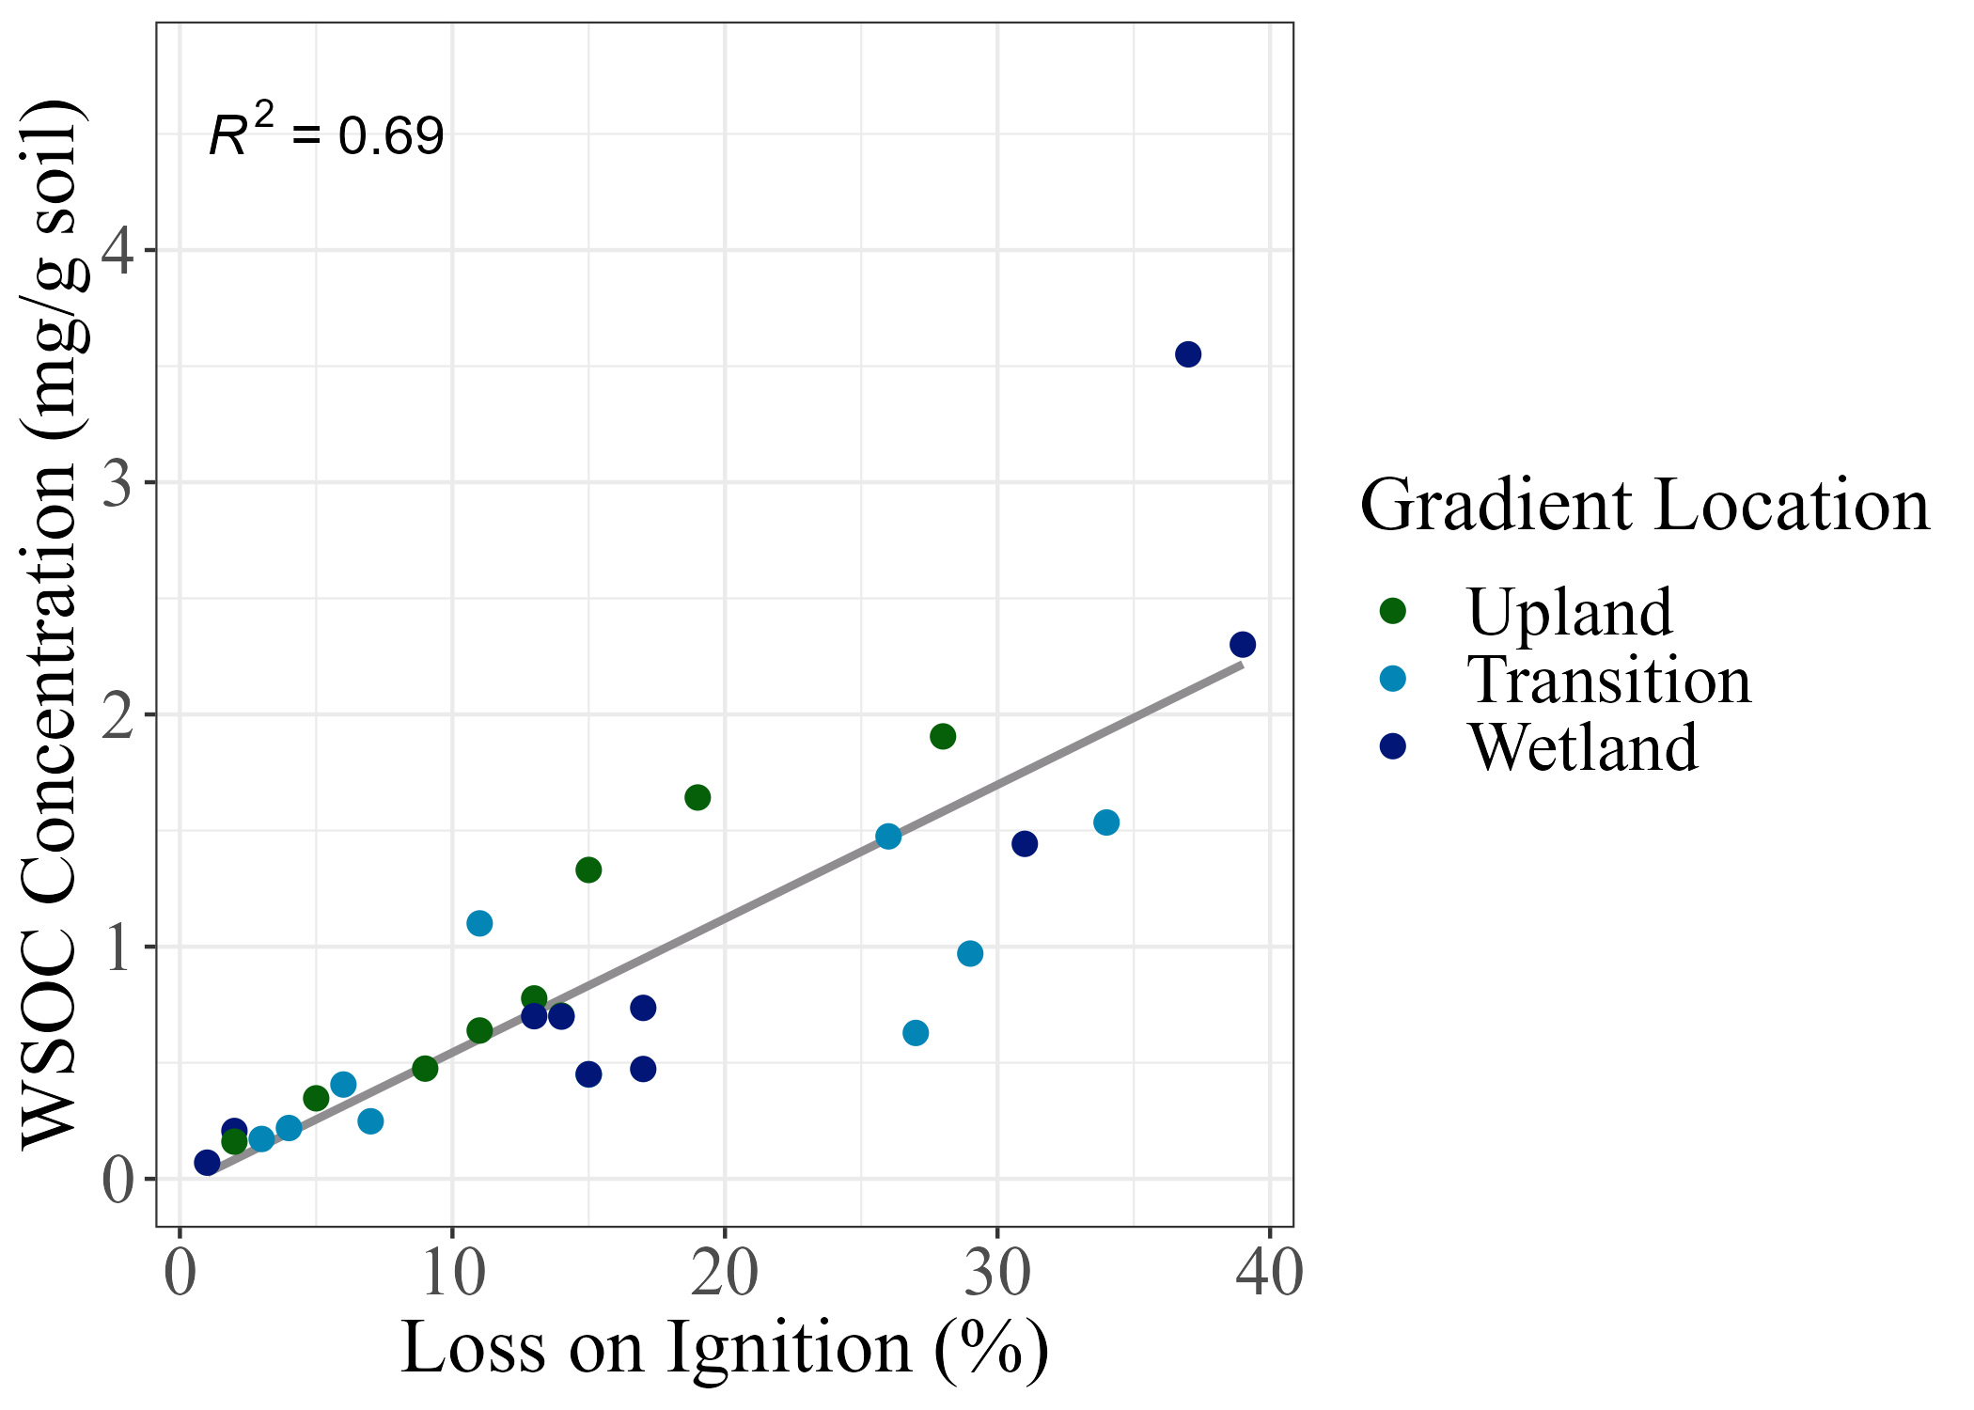
Relationship between WSOC Concentration and Loss on Ignition Percentage

Slide 23
Example Data Outputs from the Aqualog
Absorbance:

Slide 24
Example Data Outputs from the Aqualog
Fluorescence:

Slide 25
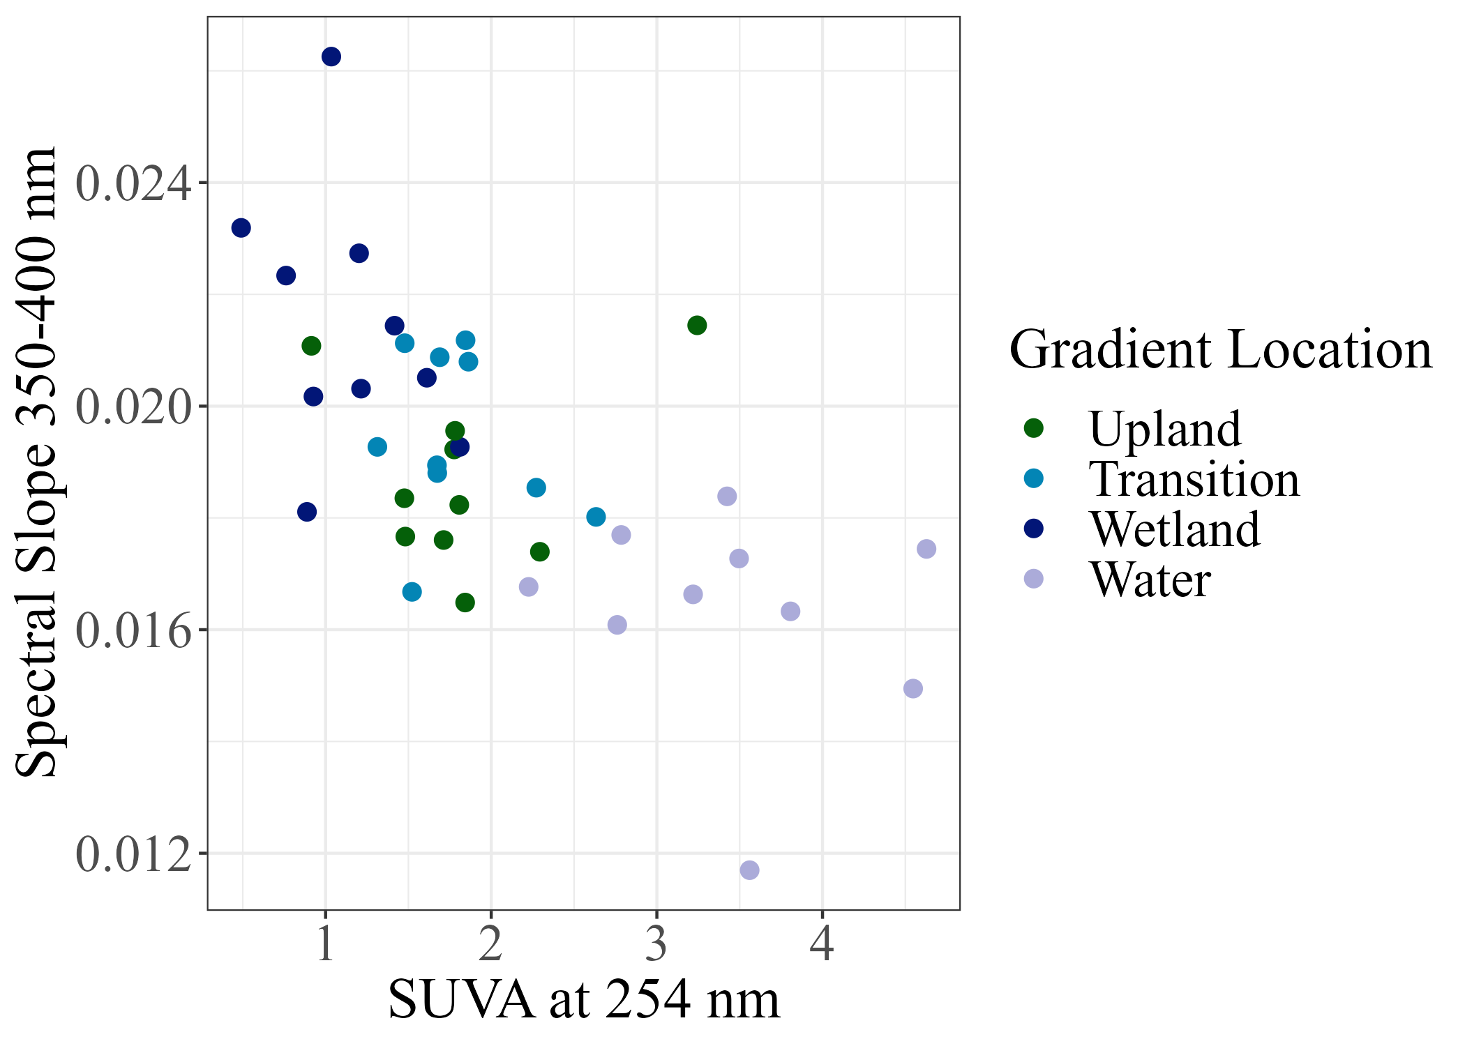
Absorbance Metrics
Increasing aromaticity and/or increasing molecular weight
Increasing aromaticity

Slide 26
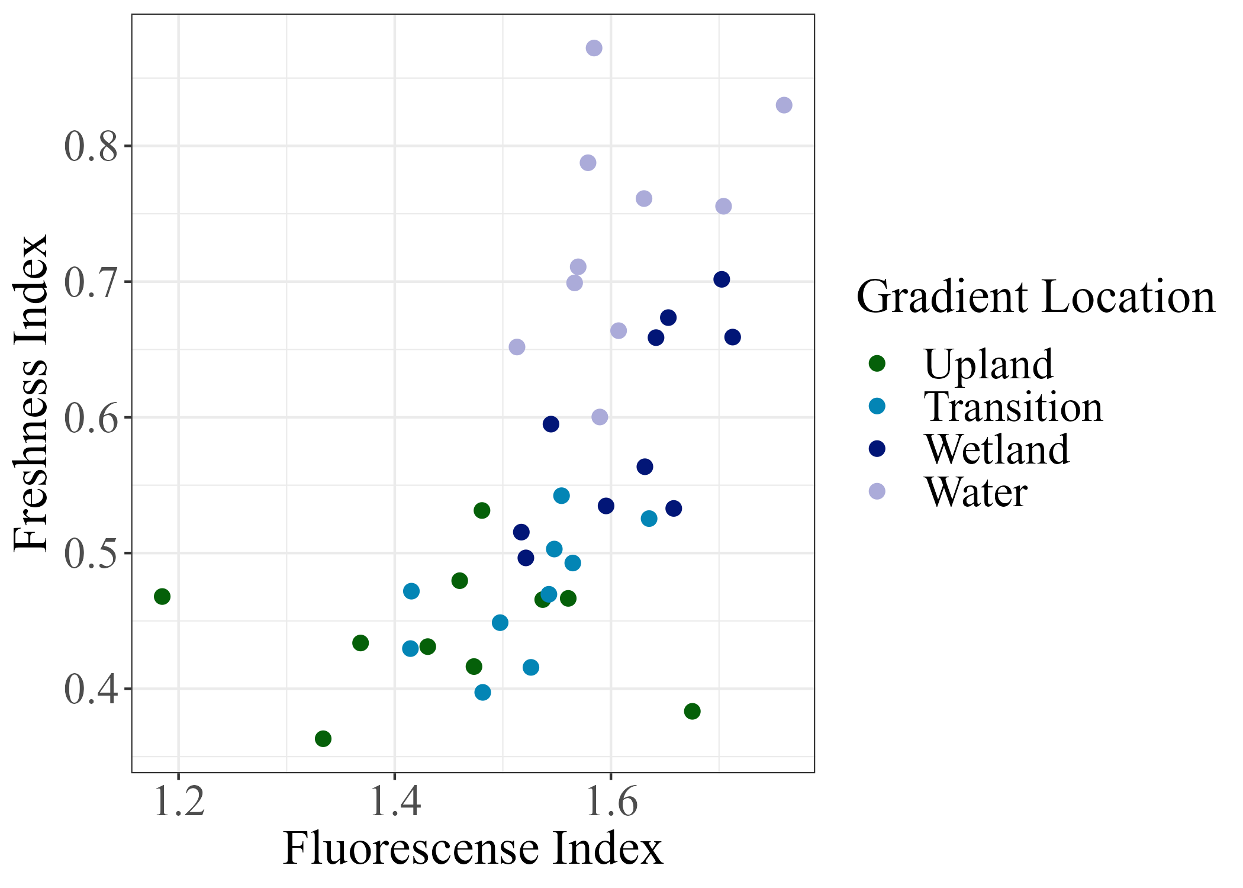
Fluorescence Metrics
Increasing proportions of recently produced DOM
Terrestrial
Microbial

